Slide 1
Turnout and Electoral Supply
Alexander Wuttke
Notes:
2023

Slide 2
The Times They Are a-Changin’
Dealignment and diminishing norms of
electoral participation (Dalton 2009, 2013, Weβels 2007)
Cognitive Mobilization (Dalton 2012)
Turnout Decline
Context-Dependent, Situationist Decision-Making
Notes:
Duty to Vote as an ethical imperative no matter what plattforms that parties have to offer
Norms and Social Identities are becoming less important in influencing

Slide 3
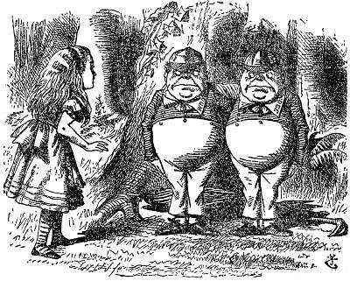
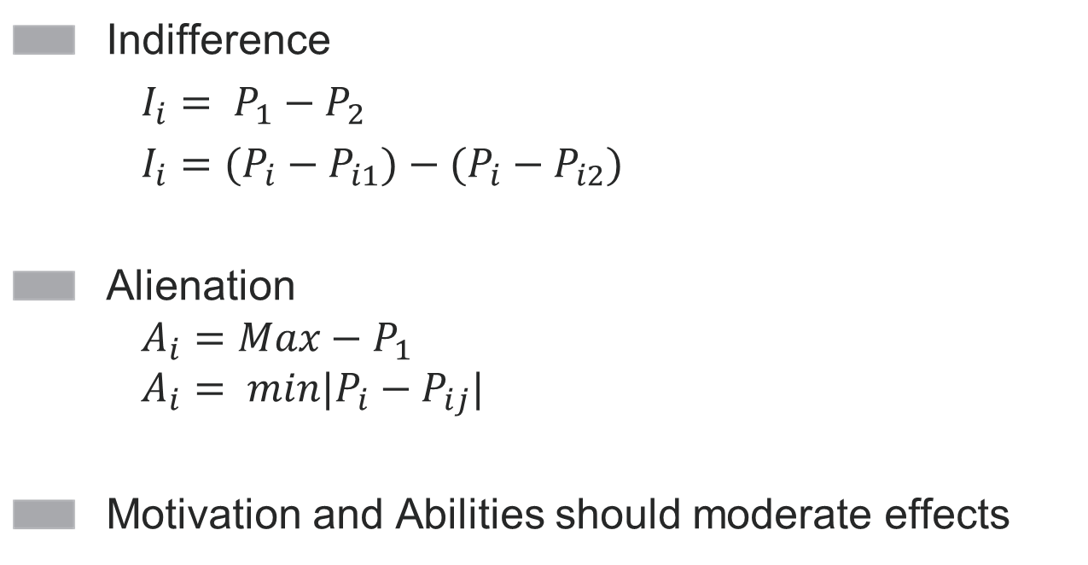
Alienation and Indifference
Indifference
$I_{i}= P_{1}−P_{2}$
$I_{i}=(P_{i}−P_{i1})−(P_{i}−P_{i2})$
Alienation $A_{i}=Max−P_{1}$ $A_{i}= {min|P}_{i}−P_{ij}|$
Motivation and Abilities should moderate effects
„Tweedledum and Tweedledee Politics“ (Adams et al. 2007: 67)
Notes:
Prominent in the public discourse. It´s in the parties hand to boost voter turnout:
Post-Democracy: SPD and CDU… They´re all the same…
Other Ways of Measurement: Indifference as Difference between Main-Contestants (CDU/CSU and SPD) - > Results basically the same

Slide 4
Literature
Small, but consistent effects (Adams et al. 2006; Plane und Gershtenson 2004; Steinbrecher 2014, Dinas et al. 2014)
Especially in comparison to rivalling predictors such as generalized attitudes towards democracy and voting (Faas 2010; Steinbrecher 2014)
Notes:
Sozwiss
1d28.ddr

Slide 5
Alienation, Indifference and Causality

Association
Isolation
Direction
(Bollen 1989)
“The problem of causal inference is fundamentally one of unobservables. “
(Halaby 2004, 508)
Notes:
Two things that are wrong with extant research:
Direction: Do they stay home because they are not represented or arent they represented because they´d stay home anyway
Direction: Image a group of voters doesnt vote anyway (young voters). In consequence parties direct their platform to the elderly. Seemingly correlation would be spurious
First, a cause x must have an association with an outcome y. Second, x must be isolated from all other causes of y to guard against spurious associations. Finally, x must come before y to establish the direction of the effect.11

Slide 6
Two Improvements for a consistent estimation
Longitudinal Data
Covariates better conceptualized as mediators?

Slide 7
Causality and Longitudinal Data
Long-Term-Panels
Conditional Fixed Effect Logistical Regression
$Log(\frac{p_{it}}{1−p_{it}})=μ+βx_{it}+γ{(z}_{it})+α_{i}$
$μ$=Intercept, $x$=Time-Varying Predictors, $z$=Time-Invariant Predictors, $α$=Unobsorved Time-Invariant-Predictors (Varying between Individuals)
$Log\left(\frac{p_{i}}{1−p_{i}}\right)=\left(μ_{2}−μ_{1}\right)+β{(x}_{i2}−x_{i1})$
Notes:
Conditional Fixed Effects
Similar to the regular fixed effects Modells. What happens in the background technically, in case of T>2 is different, though (incidental parameters problem).
$μ$=mu
If something happens in the world, it must be caused byy something that happened before
X=Being born into a workers family -> Cannt be the cause of having voting 2002 but not 2005. Rather. Being disappointed with the social democrats, giving up your party identification and thus not feeling the need to go to the voting booth to feel the satisfaction of supporting the party you identify with is the causal chain.
Events can only be caused by events. And and event can only be caused by something that happened.
Long-Term Panels are mentioned three times in GLES Bibliography
We can only make inferences about the world we can observe. If the parties could move more voters to turn out out if they changed they positions more radically than they are doing it now (in what ever direction), we cannot answer. We can only estimate the magnitude of influence of their observed position changed on voter turnout.
All we would say beyond this, would be an extrapolation into unoserved fiction

Slide 8
Conditional Fixed Effects Modell 2009-2013
 | Odds Ratio
Policy-Alienation | 1.02
Policy-Indifference | 0.78
Likability-Alienation | .67
Likability-Indifference | .85
Civic Duty | 34.20*
PID | .18
Political Interest | 285.25*
Individuals | 37
Observations | 74

Slide 9
Pooling Datasets
Boosting Sample Size
Pooled available long-term panels
Pre- und post-election surveys (intentions and reported behavior)
Estimator as the averaged effects of perceived party repositioning between 1994-2013 on the decision to turn out to vote
Notes:
5 Long-Term Panels, beginning with the 1994 election. Each accompanying voters over the course of three elections
And: We Use both Voting Intentions as Well as Reported Behavior
Pooling does not lead to inconsistent estimations
The estimator is the average across elections from 1994 to 2013

Slide 10
Switchers
Switching is rather uncommon
Limitation 1: Over the course of
three elections
Possible Limitation 2: Do I under-/overestimate the amount of Switching because of Panel Attrition?
Notes:
(Only) 12,95% of all Panel-Respondents are Switchers
Looking at the whole electorate; Alienation & Indifference cannt be that big a thing, because fluctuation is rather unusual
Einschränkung: When looking at
Weighted: Regional and demographic (not user in FE Analysis) 12,19%
Problem: If non-switchers dont like answering surveys, the share of switchers would be overestimated

Slide 11
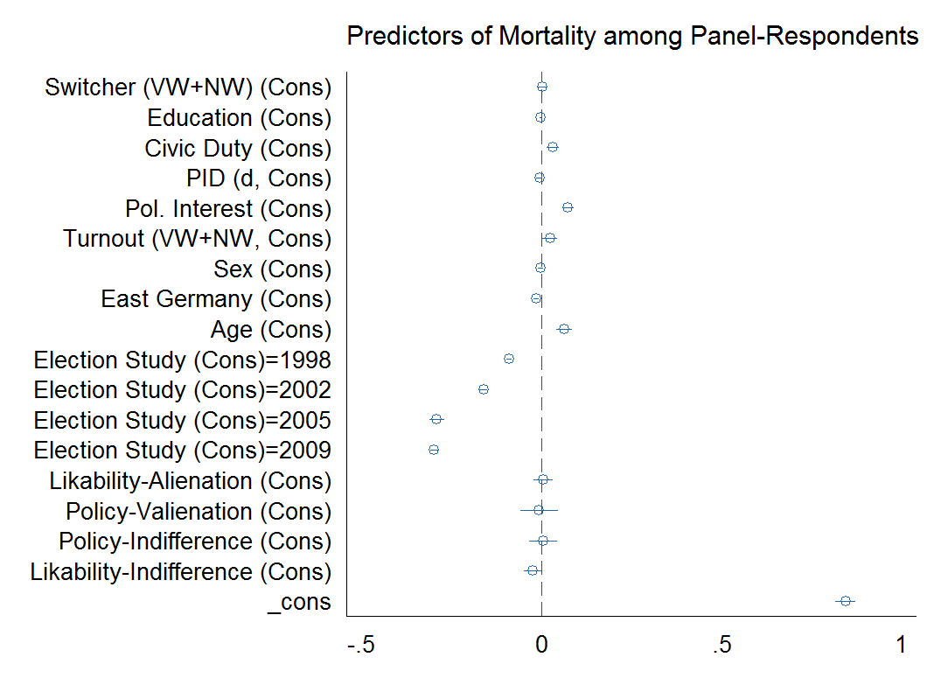
Average marginal effects, random effects logistical regression
Notes:
I cannt know if Switchers are more likely to participate in the second wave, because for those who participated only in the first wave, we don´t know if they are switchers or not
Among those who did participate in wave 1 and wave 2, being a switcher is not significantly correlated with panel-mortality.
Attrition seems not to be a problem for estimating share of switchers.
[Actually, what matters is the Principal Investigator that conducted to Study the respondent was part of]

Slide 12
Conditional Fixed Effects Logitical Regression
 | Odds Ratio | P-value
Policy-Alienation | 0.99 [0.78; 1.28] | 0.92
Policy-Indifference | 0.934 [0.77; 1.14] | 0.50
Likability-Alienation | 0.89 [0.78; 1.01] | 0.07
Likability-Indifference | 0.96 [0.82; 1.11] | 0.61
Civic Duty | 22.20*** [9.6; 52.82] | 0.00
PID | 1.40 [0.89; 2.20] | 0.13
Political Interest | 4.16* [1.35; 12.33] | 0.13
Satisfaction w/ Democracy | 2.63** [1.09; 6.36] | 0.03
Individuals | 321
Observations | 678
Notes:
Now that we can say that our sample is not too biased… What makes switchers switch?
We would expect values between zero and 1
Unfortunately, I cannt visualize ut
When you change from being not at all satisfied with democracy to completely satisied, you are 2.63 times more likely to change from nonvoter to voter

Slide 13
Conditional Fixed Effects Logitical Regression
Odds Ratios | Cognitive Mobilisation: Low | Cognitive Mobilisation: High
Policy-Alienation | 0.95 [0.71; 1.32] | 1.01 [0.70; 1.50]
Policy-Indifference | 0.89 [0.64; 1.25] | 0.95 [0.74; 1.24]
Likability-Alienation | 1.02 [0.86; 1.21] | 0.73** [0.58; 0.91]
Likability-Indifference | 1.04 [0.82; 1.31] | .88 [0.72; 1.08]
Civic Duty | 22.40*** [6.10; 75.06] | 26.83*** [7.75 91.03]
PID | 1.57* [1.00; 3.65] | 1.32 [0.74; 2.58]
Political Interest | 3.82* [0.76; 19.72] | 3.70 [0.69; 19.85]
Satisfaction w/ Democracy | 3.83* [1.00; 14.62] | 1.63 [0.46; 5.66]
Individuals | 162 | 159
Observations | 339 | 343
Notes:
The moderating effect of CogMob is also problematic. Further Sensitivity Analyses of Panel Mortality shows that CogMob strongly predicts PanelMortality->Those with higher Effect Rates are overrepresented in our sample
So… Effect is pretty small…
On a 10 point scale, half of the voter´s change their likability-rating between two election not more than two points. A one point-change decreases the odds of being a voter by 30%.
So…. Onl small direct effects… what about indirect effects?

Slide 14
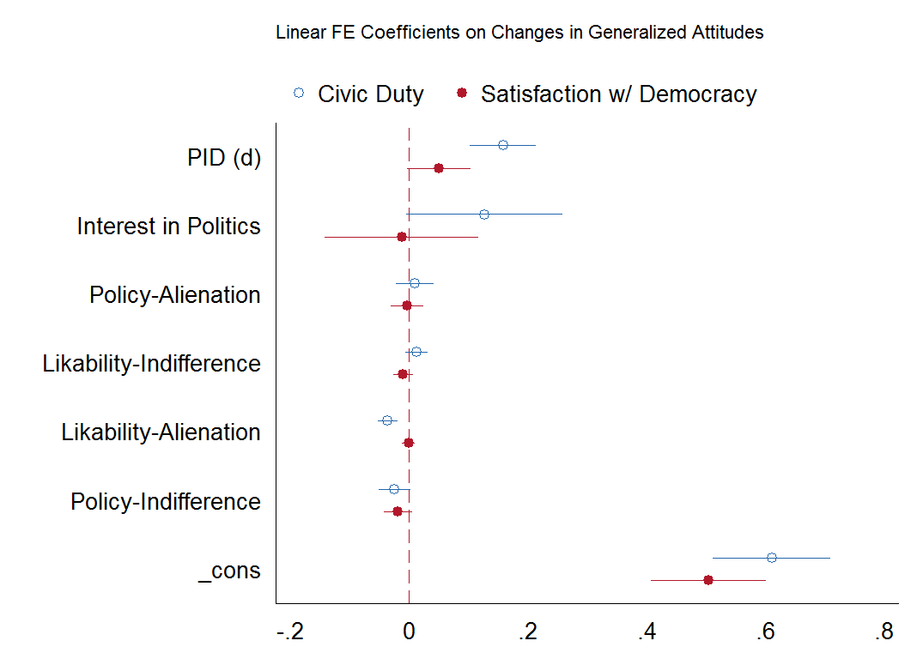

Slide 15
Conclusio and Sensitivity
Only one in ten voters switches turnout behavior
Among those, effects of party repositioning is small to nonexistent (and still overestimated)
Same results excluding panel-mutants
Same results using Leading-Parties-Indifference

Slide 16
Open Questions and Open Tasks
Structural Equation Modelling for Mediation Analysis?
Visualizing the Results?
Marginal Effects, T=2?
Is it technically possible to use wires that don´t belong to my laptop (yours…) to charge my laptop?

Slide 17
Literature
Adams, James; Dow, Jay; III, Samuel Merrill (2006): The Political Consequences of Alienation-Based and Indifference-Based Voter Abstention: Applications to Presidential Elections. In: Political Behavior 28 (1), S. 65–86. DOI: 10.2307/4500210.
APSA Task Force Report (1950): Toward a more responsible Two-Party-System. A Report of the Committee on Political Parties. In: American Political Science Review 44 (2).
Blais, Andre; Singh, Shane; Dumitrescu, Delia (2014): Political Institutions, Perceptions of Representation, and the Turnout Decision. In: Jacques J. A. Thomassen (Hg.): Elections and democracy. Representation and accountability. 1. ed. Oxford: Oxford Univ. Press (Comparative study of electoral systems), S. 99–112.
Dalton, Russell J. (2009): The good citizen. How a younger generation is reshaping American politics. Rev. ed. Washington, D.C.: CQ Press.
Dalton, Russell J. (2012): Apartisans and the changing German electorate. In: Special Symposium: Germany's Federal Election September 2009 31 (1), S. 35–45.
Dalton, Russell J. (2013): The apartisan American. Dealignment and changing electoral politics. Thousand Oaks, Calif.: CQ Press.
Dinas, Elias; Trechsel, Alexander H.; Vassil, Kristjan (2014): A look into the mirror: Preferences, representation and electoral participation. In: Electoral Studies 36 (0), S. 290–297. DOI: 10.1016/j.electstud.2014.04.011.
Faas, Thorsten (2010): Das fast vergessene Phänomen. In: Karl-Rudolf Korte (Hg.): Die Bundestagswahl 2009: VS Verlag für Sozialwissenschaften, S. 69–86.
Halaby, Charles N. (2004): Panel Models in Sociological Research. Theory into Practice. In: Annu. Rev. Sociol. 30 (1), S. 507–544. DOI: 10.1146/annurev.soc.30.012703.110629.
Plane, Dennis L.; Gershtenson, Joseph (2004): Candidates' Ideological Locations, Abstention, and Turnout in U.S. Midterm Senate Elections. In: Political Behavior 26 (1), S. 69–93. DOI: 10.1023/B:POBE.0000022344.05382.b4.
Steinbrecher, Markus (2014): Are Alienation and Indifference the New Features of Elections? In: Bernhard Weßels, Hans Rattinger, Sigrid Roßteutscher und Rüdiger Schmitt-Beck (Hg.): Voters on the Move or on the Run?: Oxford University Press, S. 263–286.
Westle, Bettina; Schübel, Thomas; Heyder, Aribert (2013): Düstere Zukunft: Es gibt wieder Wahlen, aber niemand geht hin? In: Bernhard Weßels, Harald Schoen und Oscar W. Gabriel (Hg.): Wahlen und Wähler: Springer Fachmedien Wiesbaden, S. 475–495. Online verfügbar unter http://dx.doi.org/10.1007/978-3-658-01328-8_21.
Weβels, Bernhard (2007): Re-Mobilisierung, „Floating“ oder Abwanderung? Wechselwähler 2002 und 2005 im Vergleich. In: Frank Brettschneider, Oskar Niedermayer und Bernhard Weßels (Hg.): Die Bundestagswahl 2005: VS Verlag für Sozialwissenschaften, S. 395–419

Slide 18
Thank you

Slide 19
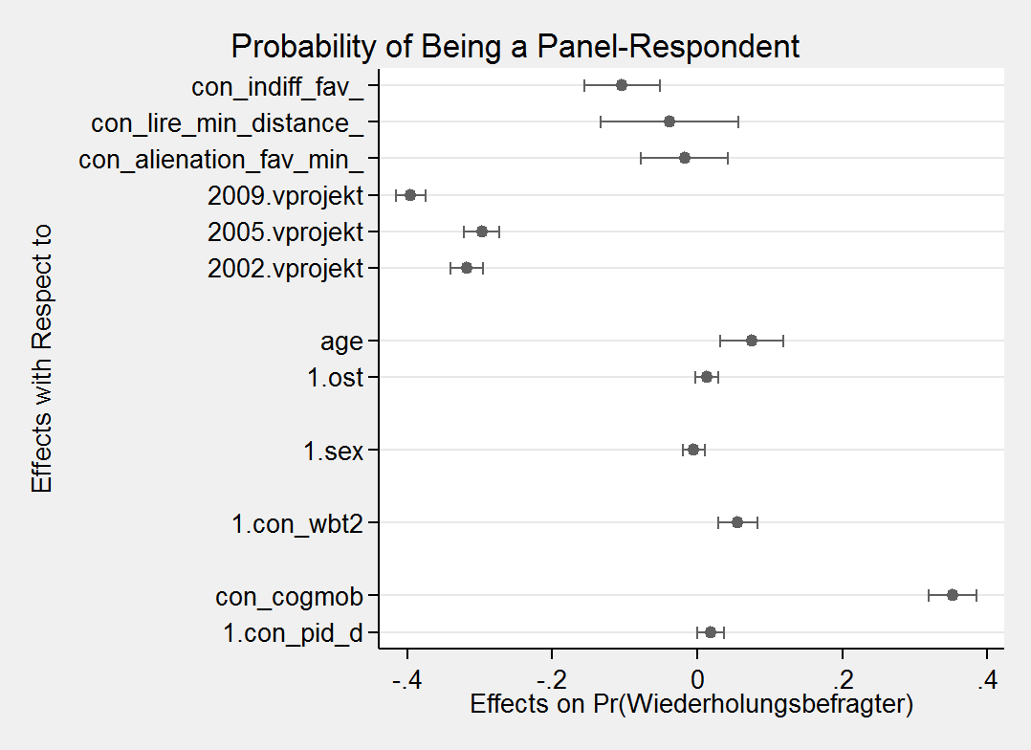
Backup

Slide 20
Electoral Supply and Turnout
nonvoters “can be converted into voters when they become sufficiently convinced that voting is important, which in turn depends upon whether a real choice is presented on matters they consider critically important”
(APSA Task Force Report 1950, 90)
Notes:
Basic Idea:
Not just stable characteristics: The culture, the institutions, the personality of the indivdual voter, but also the characteristics of this very election.
When making up their minds, voters take into account if they want to turn out at that specific election. And they do this, every time again. So, a citizen who showed up last time, does not need to do it this time.

