Slide 1
Trier School of AI meets DataFest2019
Premtim Sahitaj
Markus Hauschel
Javan Kolanowski
Nazmi Shafin
Bacher Said

Slide 2
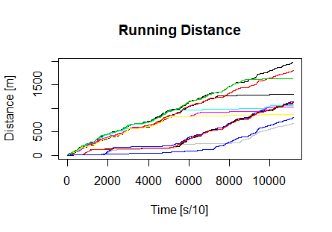
Fatigueness

Slide 3
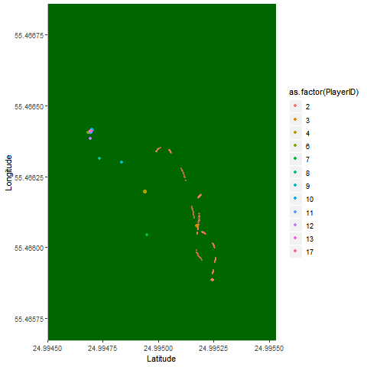
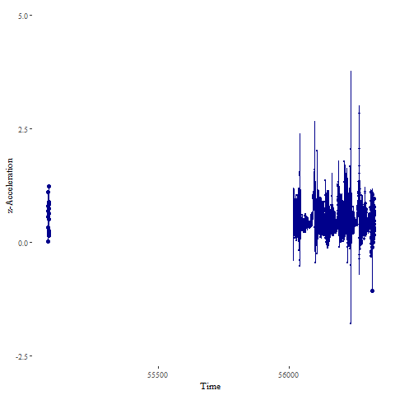
Running Insights

Slide 4
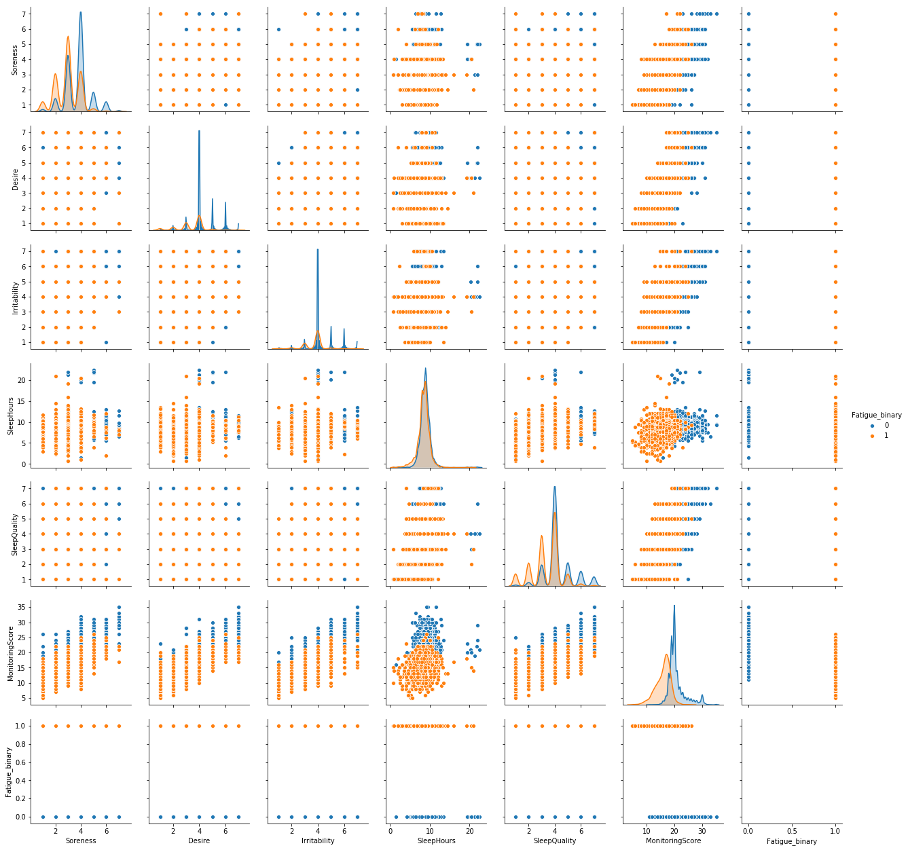
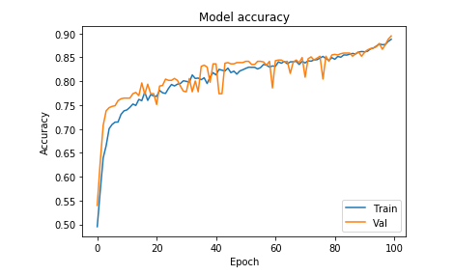
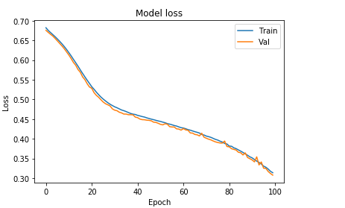
Average Fatigueness

