Slide 1
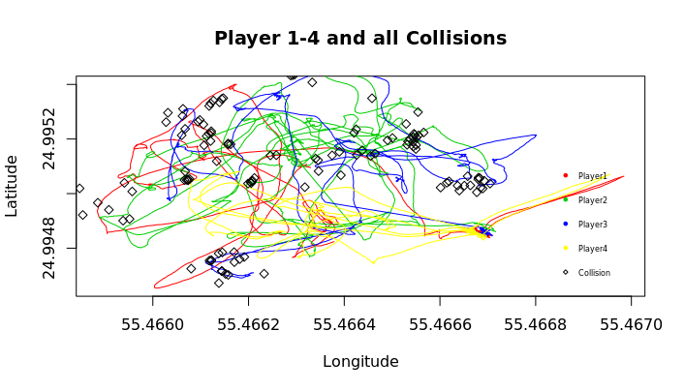
Collision Detection
o.B.d.A. Marburg Luis Winckelmann, Halya Pidstrigach, Johannes Tauscher, Georg Wille, Nicolai Lawrenz

Slide 2
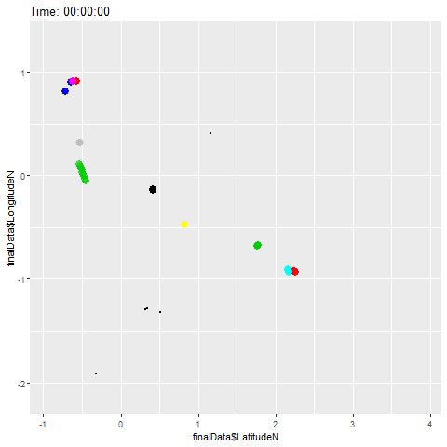
Live Collision and Distance Statistic

Slide 3
