Slide 1
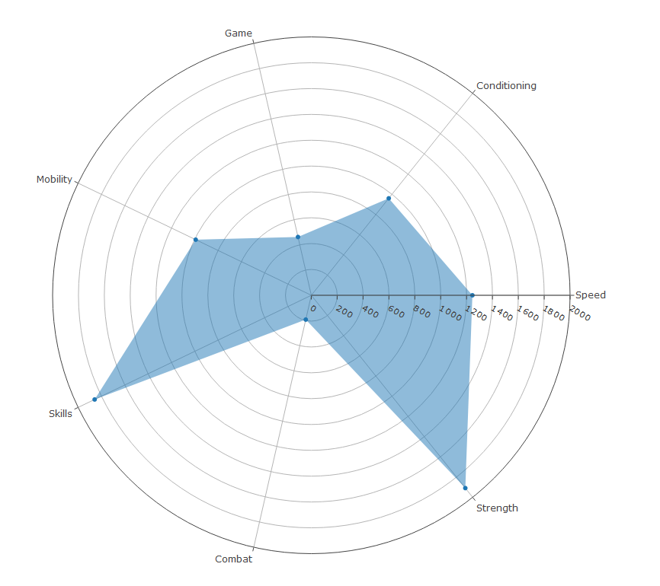
Training Types
Graph shows absolute frequency of different Session Types

Slide 2
Developing a Measurement for Game Intensity

Slide 3
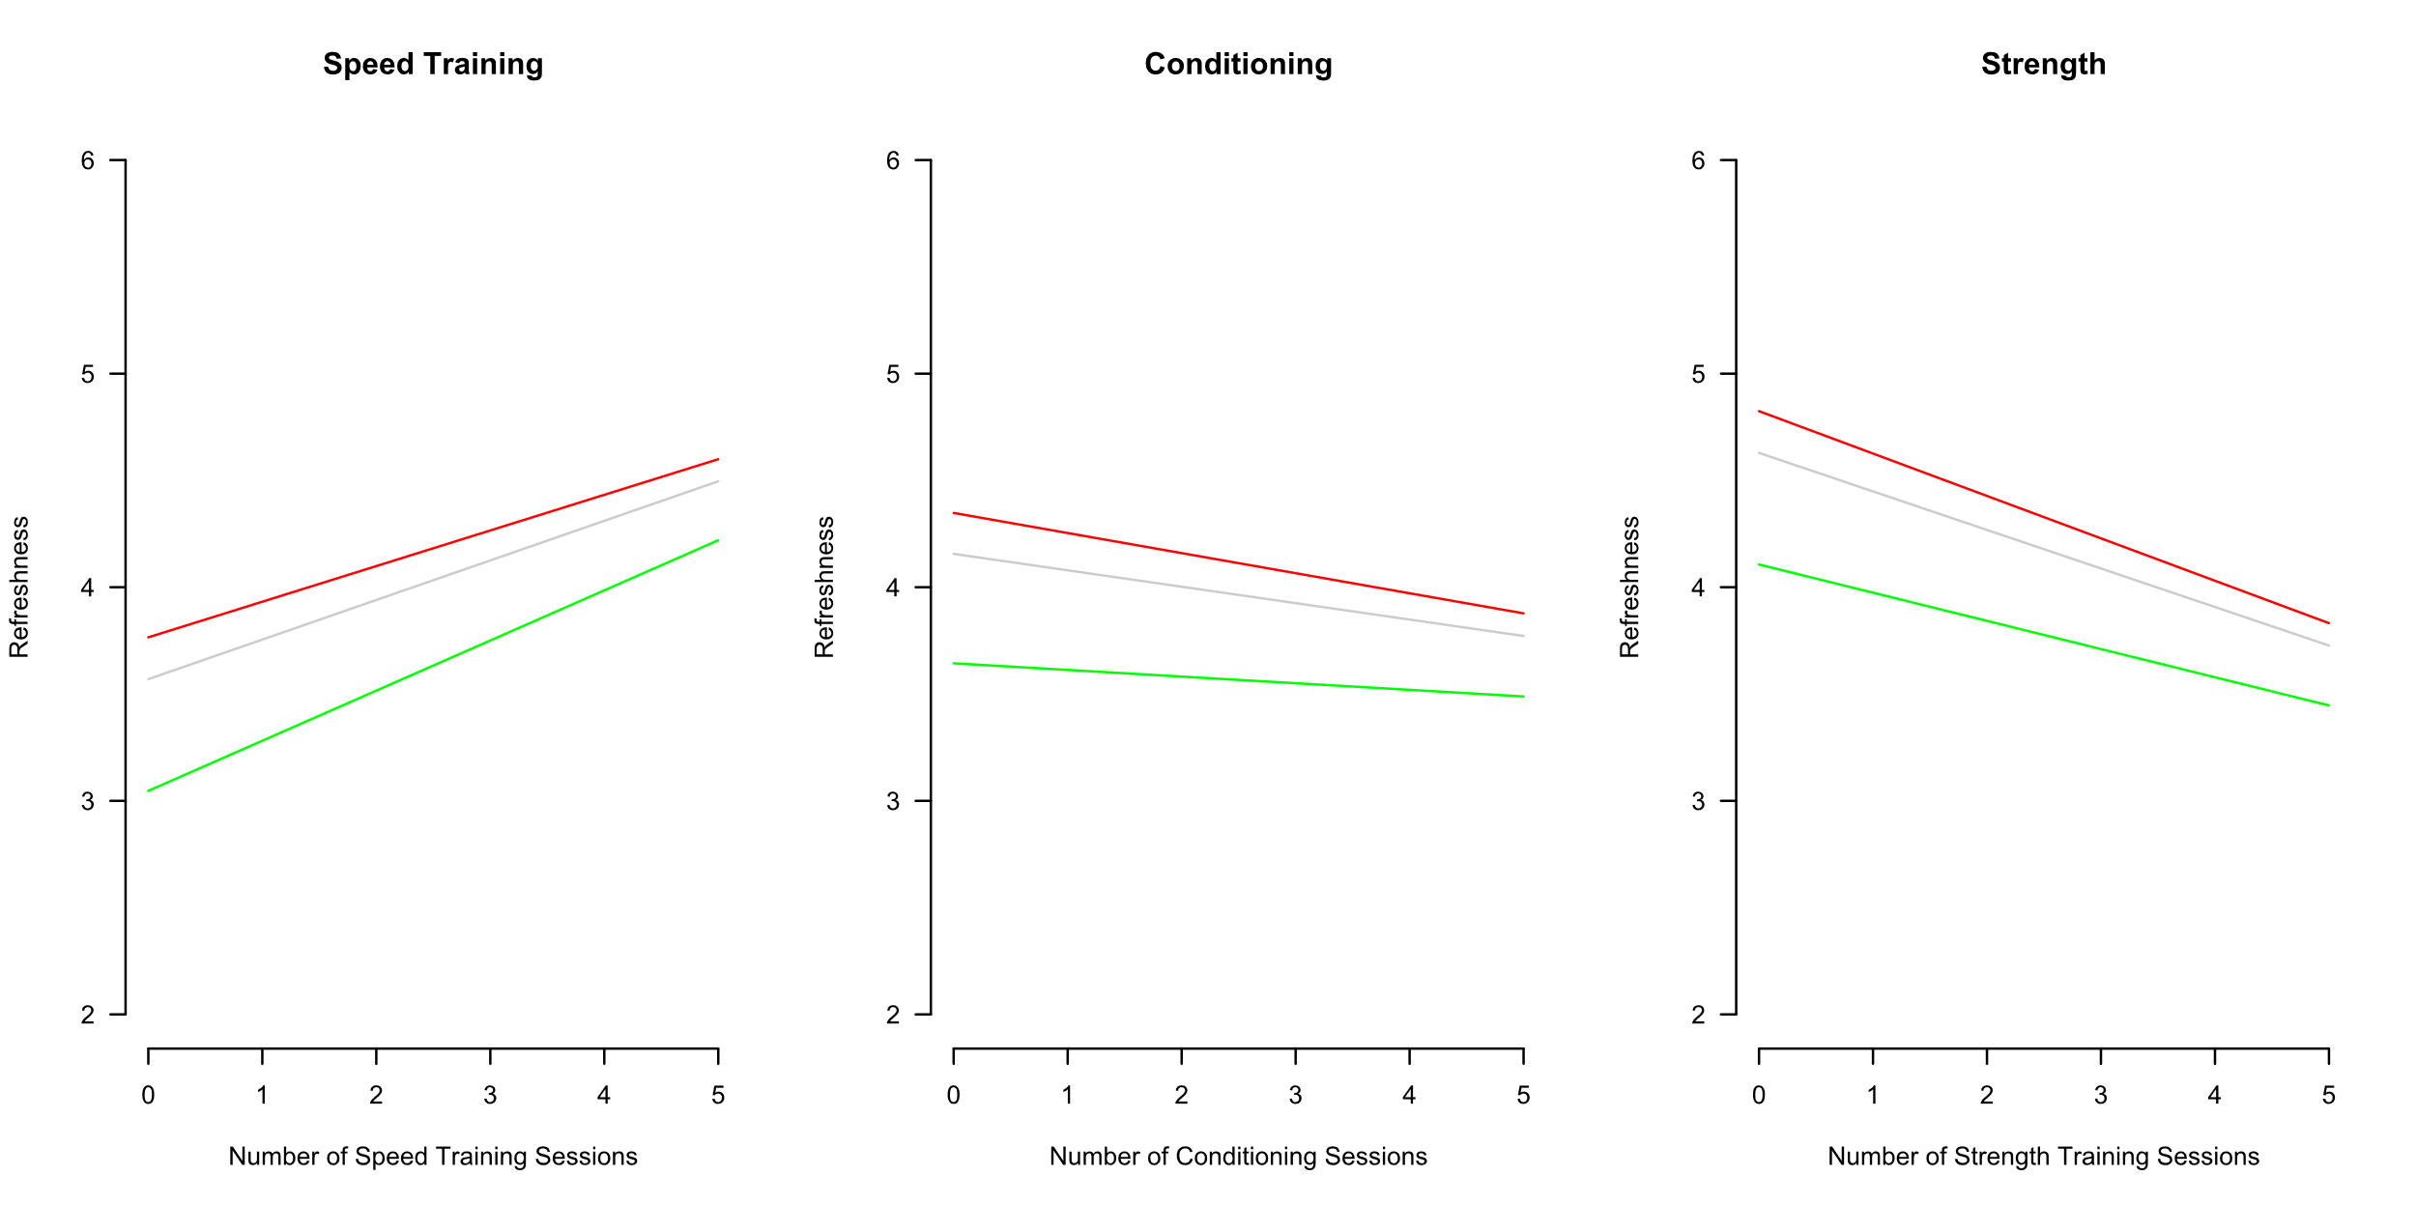
Simulating different Game/Training Intensities
Red = Low Intensity Game Grey = Medium Intensity Green = High Intensity Game

