Slide 1
Die drei Datentiere
Mehmet, Rudolf, Claudia
Datafest Mannheim 2019
May 5, 2019

Slide 2
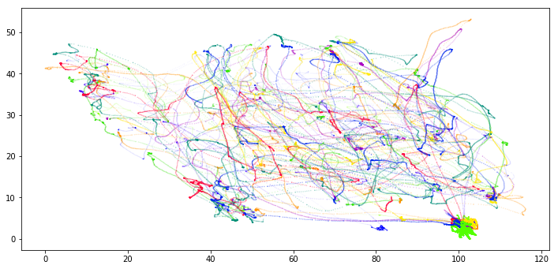
Motivation and idea
Idea: Visualize path of players
Improvement: Real Time Animation
May 5, 2019
Die drei Datentiere
2 / 4

Slide 3
Improvemnet: Simulation
Longtitude, Latitude for ﬁeld boundaries
Longtitude, Latitude , PlayerID, FrameID for movements of players
May 5, 2019
Die drei Datentiere
3 / 4
Notes:
Proof that our data is correct

Slide 4
Advantages and enhancements
May 5, 2019
Die drei Datentiere
4 / 4
Notes:
Further enhancements:
Infer position of the ball
Monitor the game from any player’s perspective
Mark speciﬁc players and focus on their actions, fade out others

