Slide 1
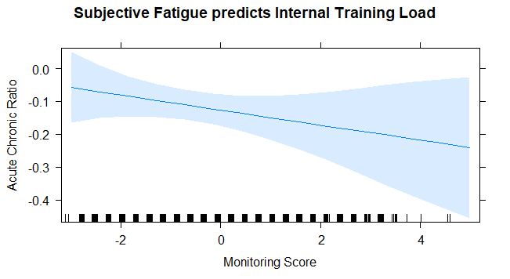
Internal Training Load
Monitoring Score
CFI = 0.961
RMSEA = 0.106
Factorial Structure
External Validity
.87
.67
.59
.59
.58
Fatigue
Desire
Soreness
Irritability
Sleep Quality
One Factor?
Drop no item
External Validity
Insight:

Slide 2
Does the Opponent Matter?
Canada vs. New Zealand
High Fatigue
Low Fatigue

Slide 3
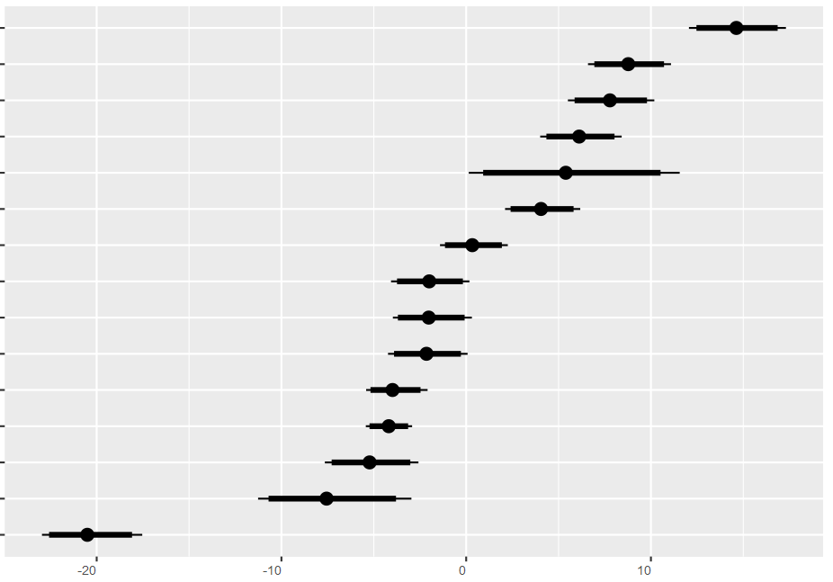
Opponent Strength Matters!
Attack Scores per Team
90% Highest Posterior Density from Bayesian MCMC with non-informal prior
New Zealand
77% Win
Boundary
Australia
Canada
USA
Brazil
France
England
Fiji
Ireland
Russia
China
Spain
Japan
Wales
Papua New Guinea
Highest Posterior Density

