Slide 1
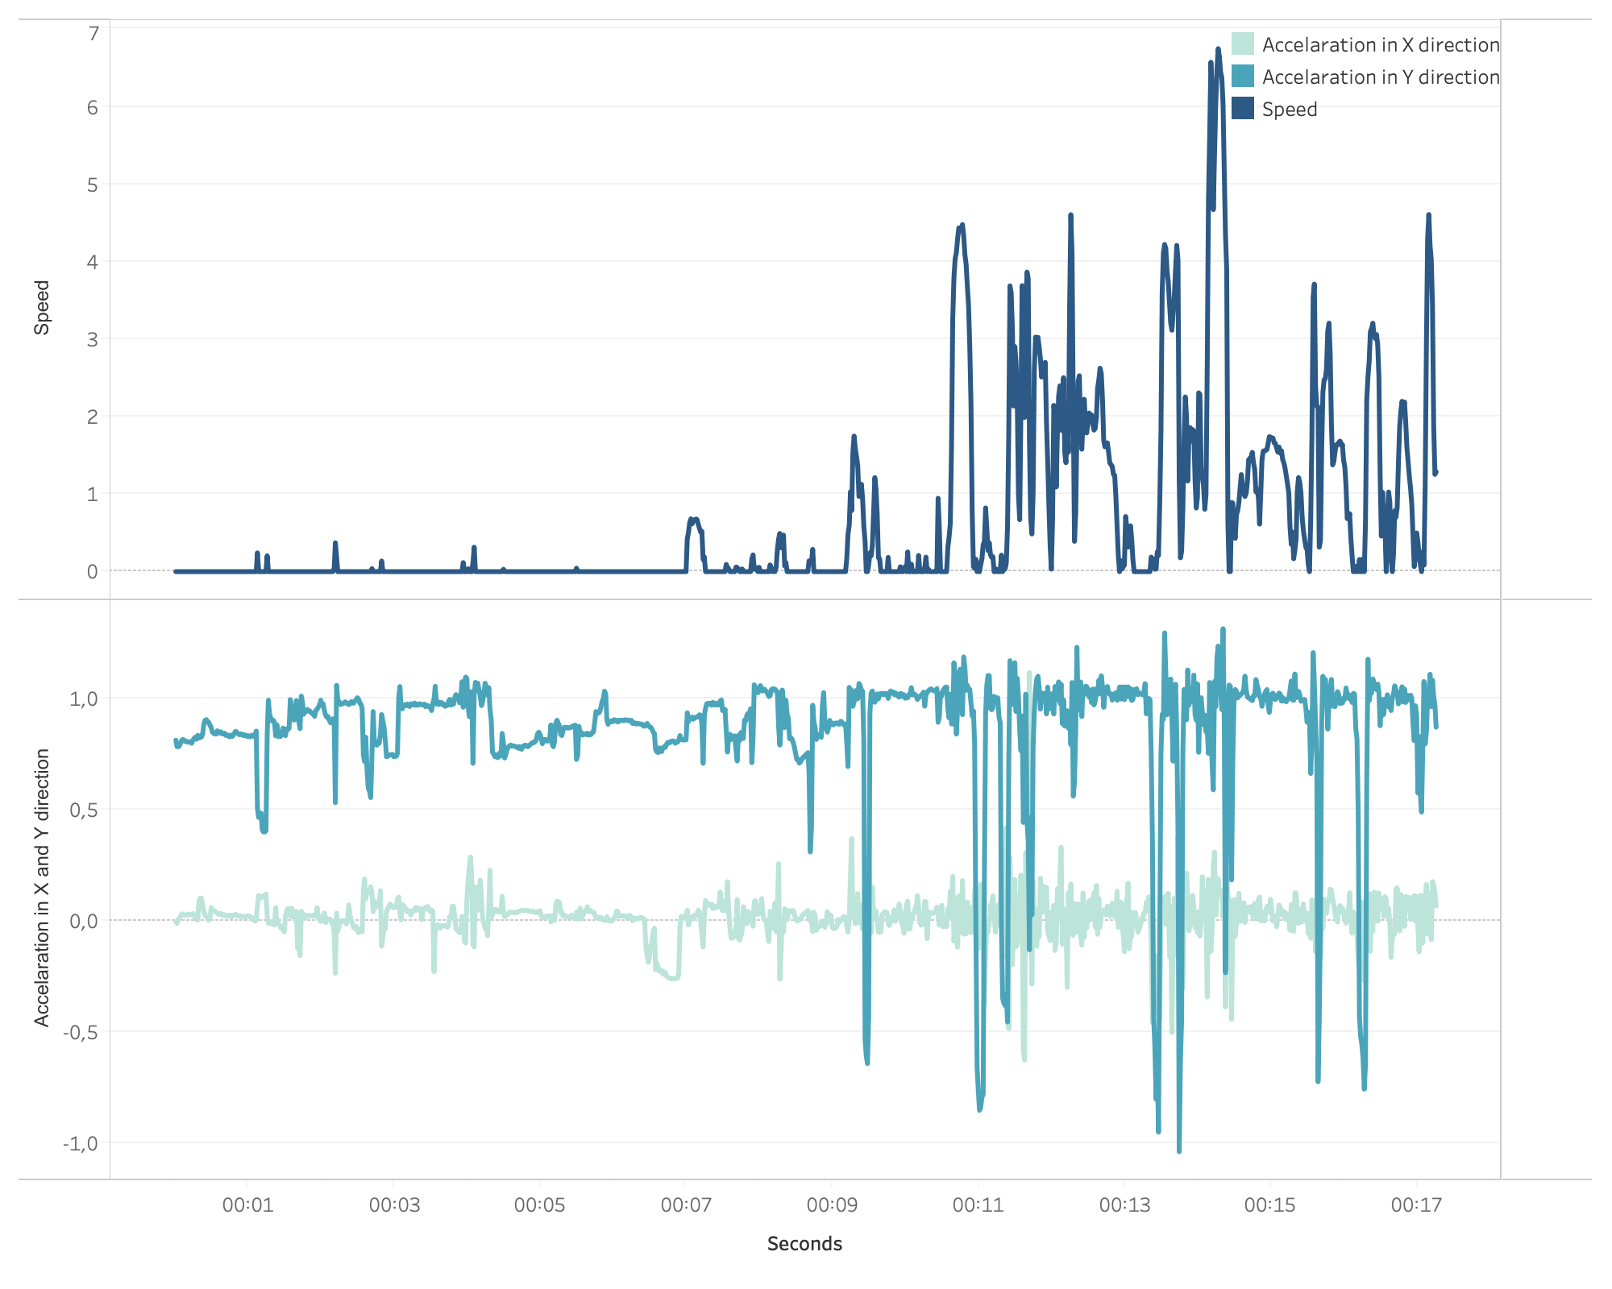
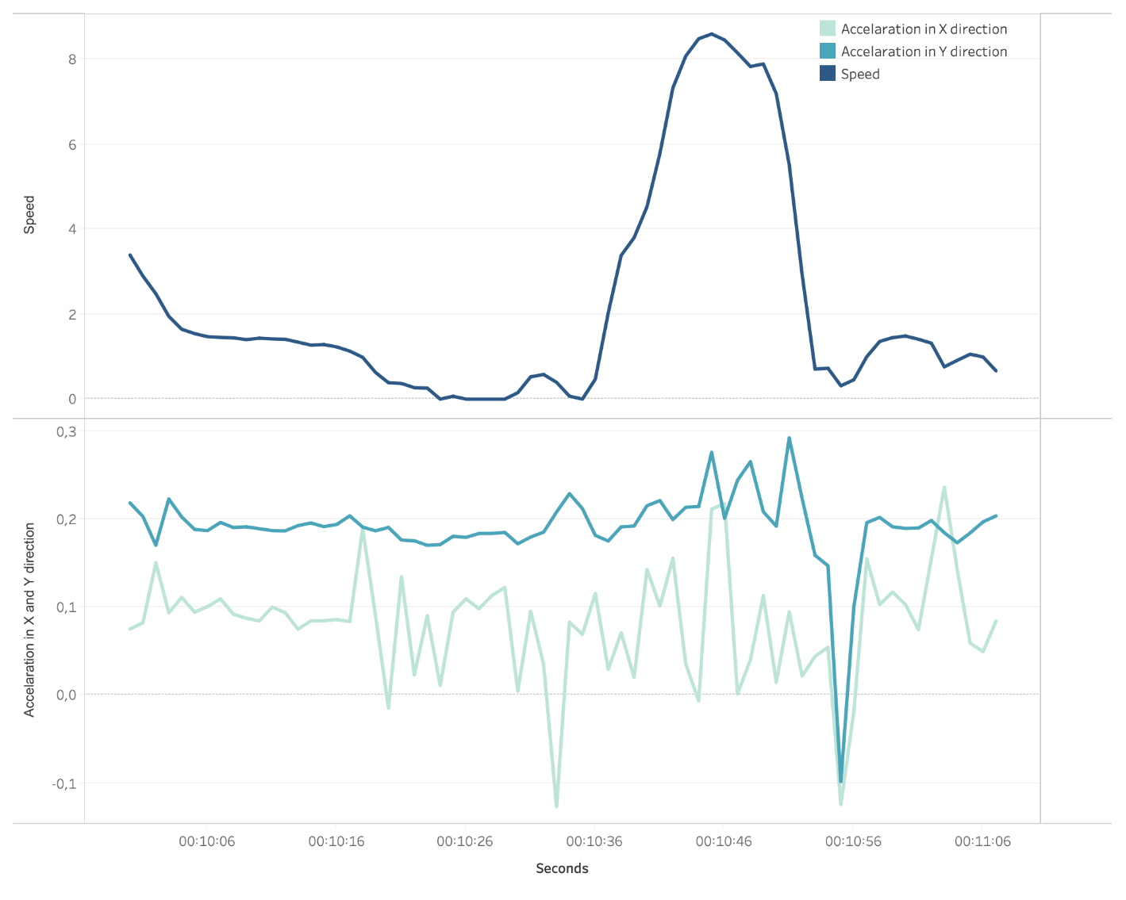
Substitute:
Try:
NEW DATA: UNLOCKED
Points per Game and Player
Total Gametime Experience
Age of Players
…

Slide 2
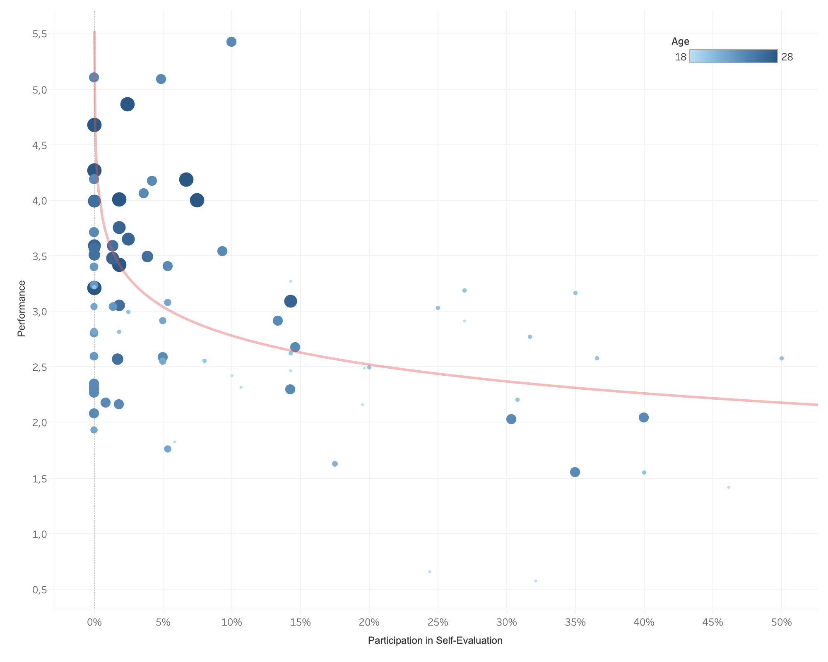
Does good perfomance lead to less Self-Evaluation?
Does dilligence in reporting lead to a better perfomance?

Slide 3
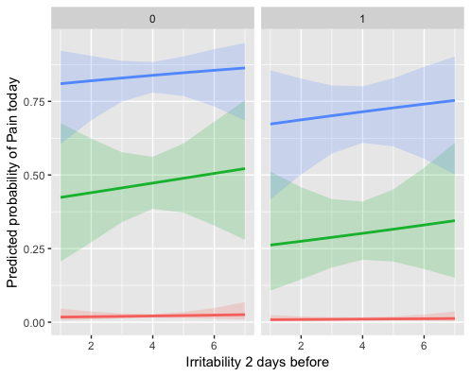
What influences Pain?
Does dilligence in reporting lead to a better perfomance?
No Pain during previous 2 days
Pain during one of the previous days
Pain on both previous days

