Slide 1
In Roc we trust
Pavel Dimitrov Chachev
Alexander Haberling
Christian Moreau
Jochen Schäfer
Sebastian Ziegler

Slide 2
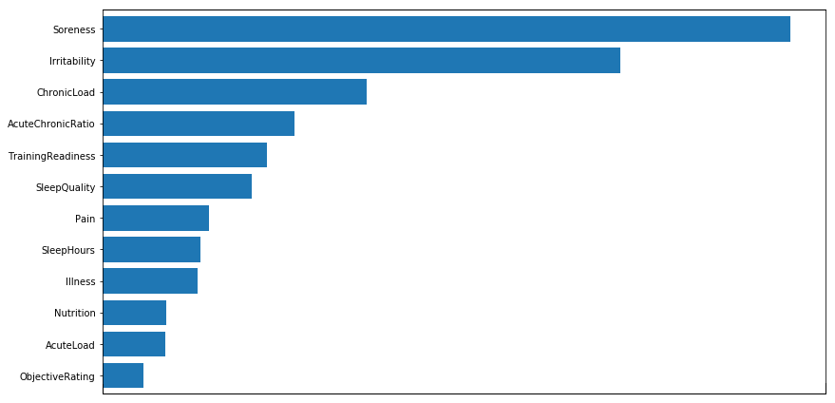
Model
Story:
Predicting the upcoming fatigue of next week allows broad adjustments of the current training plan
Subjective data:
scaled for each player seperatly
Baseline:
Predicting mode
MSE of 0.0712
Gradientboosting:
MSE of 0.0453

Slide 4
