Slide 1
Does Training Intensity Affect Likelihood of Injury?
By Hertie Analysts
May 2019
DataFest
Mannheim

Slide 2
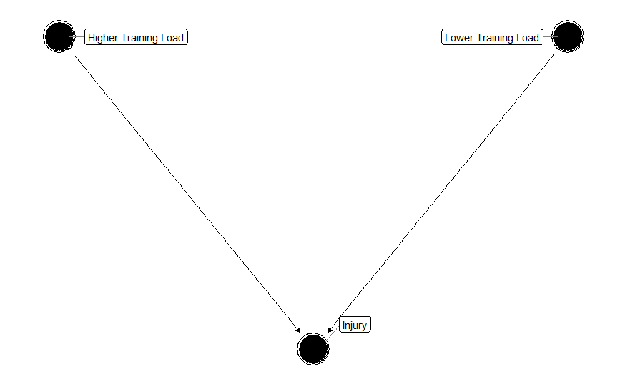
There is a common belief that a higher training load can lead to higher injury rates. However, it is also known that training has a protective effect against injury.
Higher Training Load
Lower Training Load
(Gabbett, 2015)
Research Question:
Does training intensity affect likelihood of injury?
Injury
Pain = Yes & Training = No
The response variable injury was created as a dummy, using the variables «Pain» and «Training» as proxies.

Slide 3
https://lilin.shinyapps.io/Rugby_flexdashboard2/?fbclid=IwAR3XDRVU4WDmMmsnFzMakVAzBzfs6W5_NWlVwdf2-tmA5JU7ISQUipIW6ek.

Slide 4
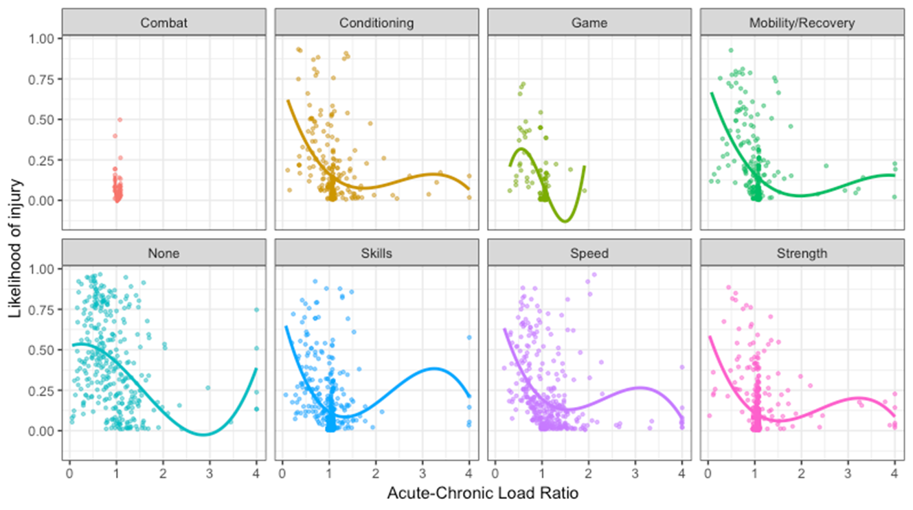
Key Finding:
The likelihood of getting injured is lowest when ACL is around 1.
Recommendation:
The best way to minimize the likelihood of getting injured is to have a consistent training load.
Outliers:
The outliers (ACL>3) show the increased training in August ahead of the beginning of the season at the end of October.

