Slide 1
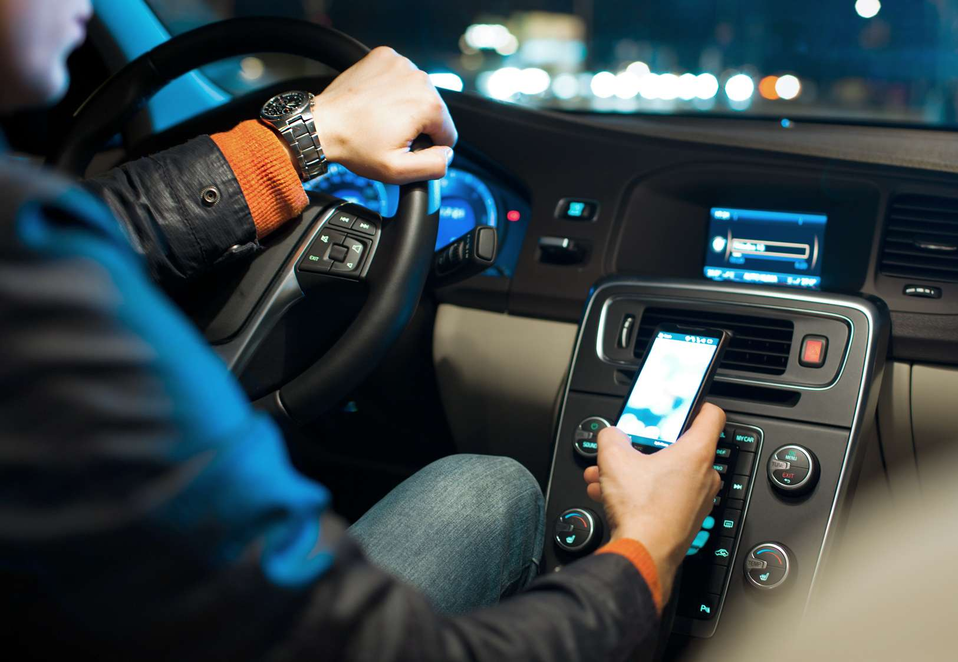
You walk, you travel, you use your phone – differently!
Presentation of approach and pilot results
Mannheim, March 20-22, 2015

Slide 2
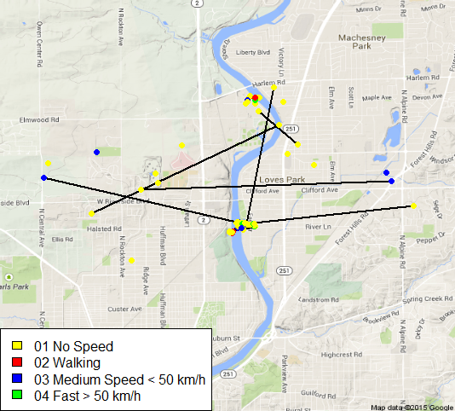
By combining different data sources, we can link App Usage to locations – GLM and Random Forests used to analyze impact
0
Approach
You walk, you travel, you use your phone – differently?
We can track Customer Movement and link it to App Usage based on time intervals
Our expectation is to find different patterns of App Usage, when a customer remains in the same place or travels at different speed levels
We want to test our hypothesis based on
Binomial GLMs per App Type
A Random Forest to evaluate the overall importance of the travelling speed compared to other influential drivers (e.g. age or gender)
What do we do, when we are not moving?
What do we do, when we are on the move?
1
2

Slide 3
We have investigated into the role of Speed of Movement for App Usage using both model-based and Machine Learning approaches
0
Approach – Back-up
Research Question
Methodological Approach
Preparing the Location Data
Classification of movement patterns based on distances covered and time needed
Preparing the App Usage Data
To allow for simplified data handling, we have aggregated Apps into purpose groups (e.g. „social media“, „navigation“)
Merging the Data
We have merged the App Usage to separate source location data based on the nearest available time interval – provided the Location data was generated within 60 minutes of the App Usage
Due to the limited availability of location data, only 100.000 cases remained after merging and cleaning for relevant Apps
Analysing the Data
Model-based statistics: GLM-based driver analysis
Machine Learning: Random Forests generate a ranking of variable importance

Slide 4
GLM data show significant effects for various app types, suggesting a relevant impact of speed of travel on app usage patterns
1
GLM Results
Key Results¹⁾
Proportion of navigation app usage
Pedestrians are least likely to use navigation services
Customers travelling at more than 50 km/h use them twice as much
30% less likely to use streaming products
25% less likely to shop online
25% less likely to play games
and 18% more likely to use Photo apps
Customers are most likely to make calls when traveling at 10-50 km/h
1) Evaluation based on a GLM predicting the likelihood to use the respective App categories. Models use a binomial distribution with a logit-link

Slide 5
Random Forests have confirmed the relative importance of Speed of Movement in determining App Usage as third most important
2
Random Forest Results
Method: Random Forest
Results: Variable Importance [%]
schematic
AGE
Employment
Employment
Speed Cluster
Speed Cluster
Gender
Device Type
Navigation
Streaming
Shopping
Gaming
Information
Social
Music
Communication
Random Forests use a combined evaluation of a multitude of decision trees
Decision Trees are randomized in each iteration, with respect to included cases and variables
Based on these iterations, an overall variable importance can be computed
Speed Clusters are confirmed as third most important influential driver
However, Age and Employment are the most crucial variables in determining App Usage

Slide 6
Thank You!

