Slide 1
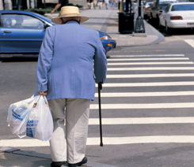
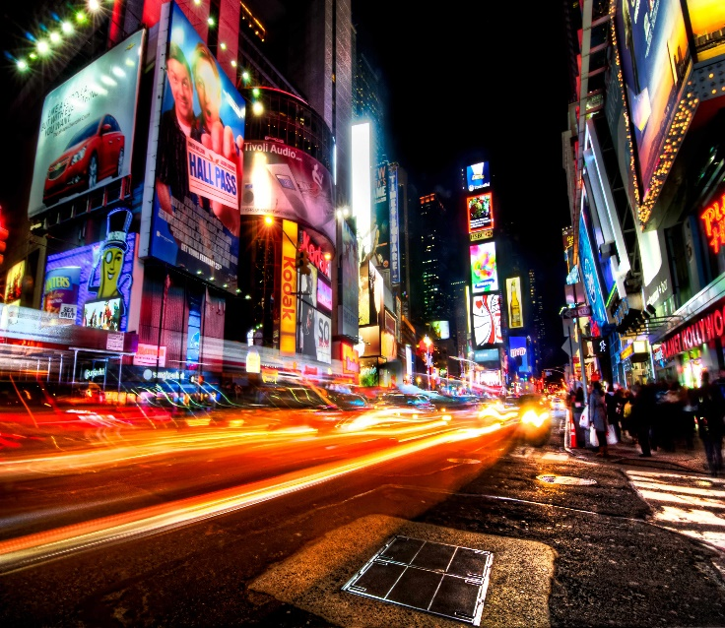
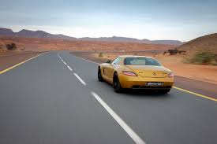
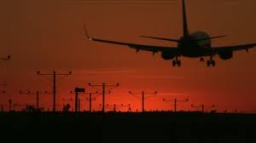
Searching for the fastest App…
…
…
Done.

Slide 2
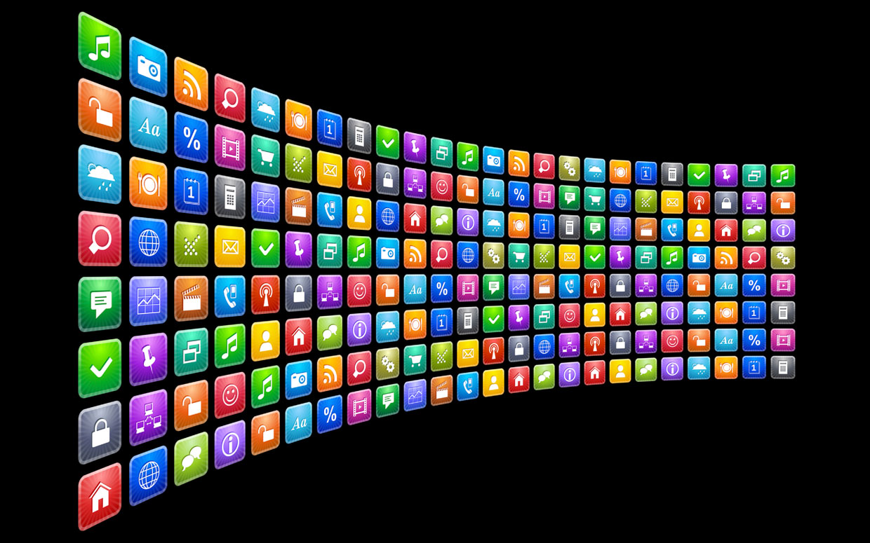
*icons: Snapchat, Instagram, Twitter

Slide 3
Right-Skewed Distributions – the faster you get, the less you use your apps
Twitter and Instagram deviate from the average
Twitter as alternative to traffic news

