Slide 1


Towards Trace-Graphs for Data-driven Test Case
Mining in the Domain of Automated Driving
Noah Metzger, Lars Hoffmann, Christian Bartelt, Heiner Stuckenschmidt, Michael Wommer, Maria Belen Bescos del Castillo

Slide 2
Agenda
Motivation
Approach
Evaluation
Discussion

Slide 3
Motivation
Traditional testing approaches are not well fitted for autonomous driving
Current approaches like accumulating certain test-mile thresholds is cost – and time-inefficient
Simulation approaches need to be well designed to compensate for real road-testing
How can we discretize and quantify real-world scenarios

Slide 4
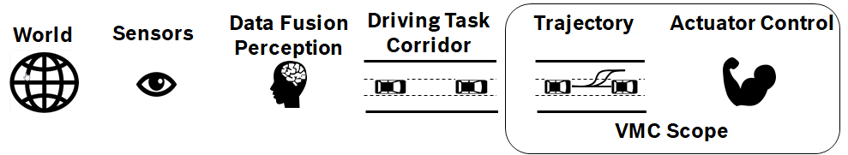


Approach – Data

Slide 5
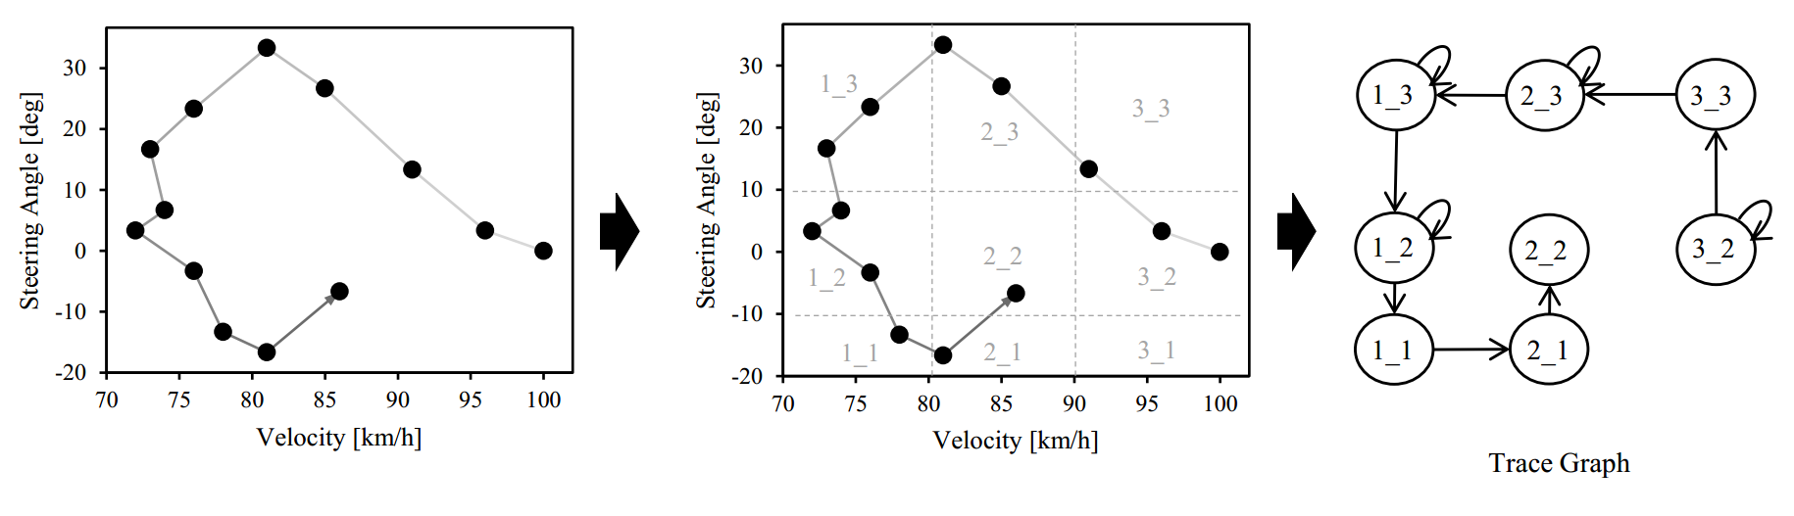
Approach – Trace Graph Transformation

Slide 6
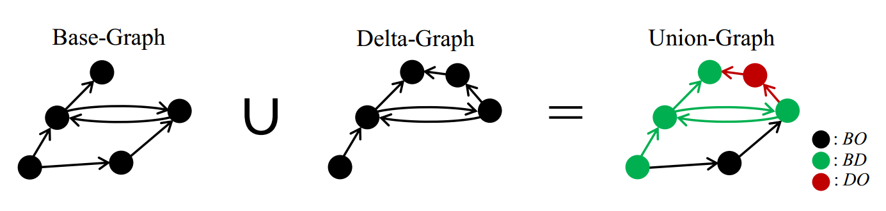
Approach – Trace Graph Coverage

Slide 7
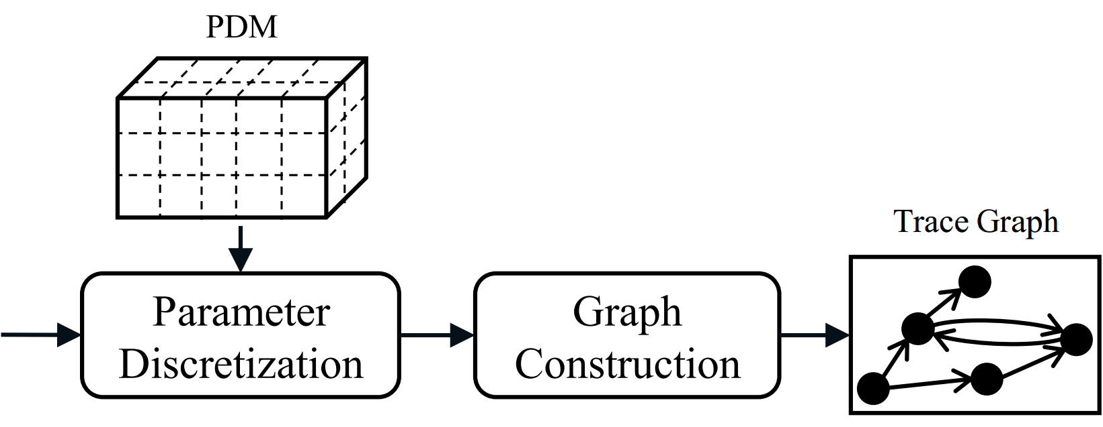
Approach – Parameter Discretization Model

Slide 8
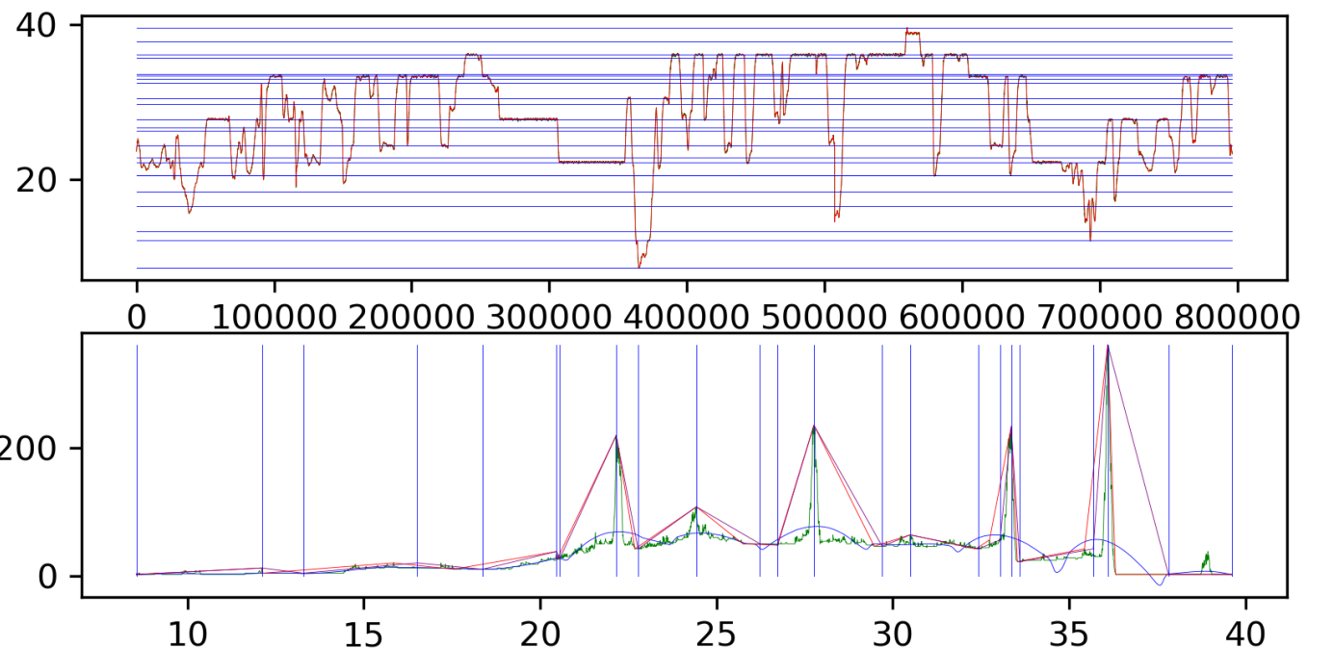
Approach – Parameter Discretization Model – Phase 1

Slide 9
Approach – Parameter Discretization Model – Phase 2
Generation of random bitstrings in the length of all clusterborders
|1110000110001100100100110000111|10001001000000101110111011|01010001110010101100110101010111111100001110011110111011110000100000101000001101110000001010101100100000001011011110100111|110111000011101010100000011000111011111001|0001011111001111100110111111111011000101|01001000001110010010011111010111111|01110000000100101110001110100101000010001001110000011100111001011010101|
Application to the base Discretization Model.
  0 = Use Clusterborder
  1 = Discard Clusterborder

Slide 10
Approach – Parameter Discretization Model – Phase 2
Evaluation of the resulting Discretization Model based on specified similarities
Crossover and mutation for next generation
Repeat the procedure until only one species remain

Slide 11
Evaluation - Data
All drives used for the evaluation has been performed on German roads and highways
5 Reference Drives which have been performed on the same route and under the same conditions
2 Free Drives
2 Hypothesis:
  Refence Drives should be similar to each other
  Free Drives should show strong differences to the free Drives

Slide 12
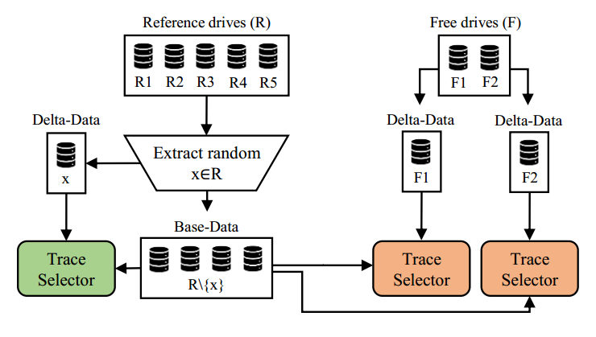
Evaluation - Design

Slide 13
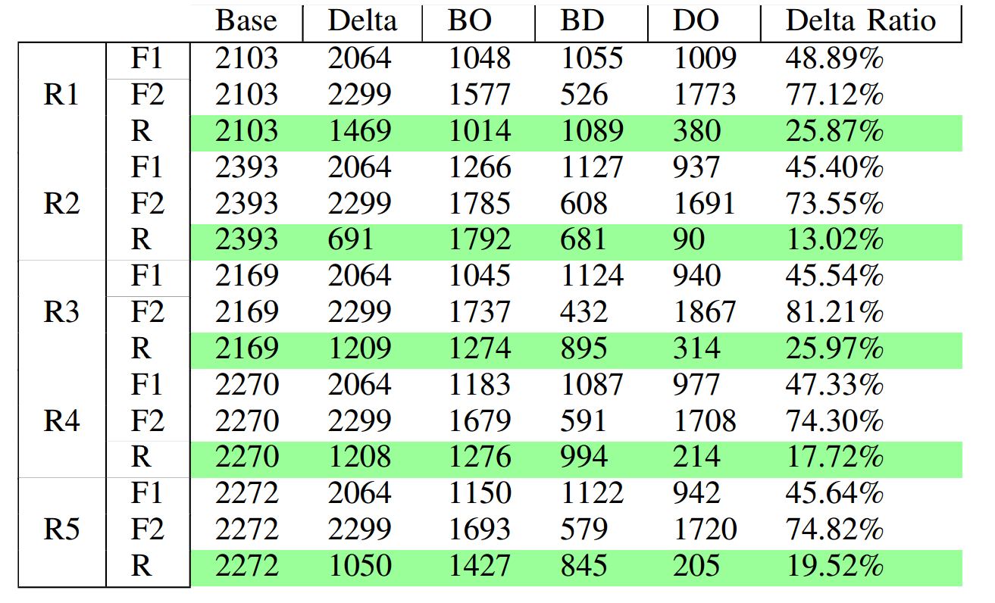
Evaluation - Results

Slide 14
Evaluation - Results
Thank You for Your Attention

