Slide 1
Robust Decision Tree Induction from Unreliable Data Sources
Christian Schreckenberger, Christian Bartelt, Heiner Stuckenschmidt

Slide 2
Outline
Introduction
Background
Related Work
Expected Information Gain
Evaluation
Conclusion

Slide 3
Introduction
Missing Data is a well established and studied Problem
  Intralearning approaches
  Preprocessing approaches
Our focus is on Decision Tree Learning
Proposition: Expected Information Gain
  Takes source reliablity into account
  Sources with low reliability in the past, will have low reliability in the future
The Goal: Increase Robustness

Slide 4
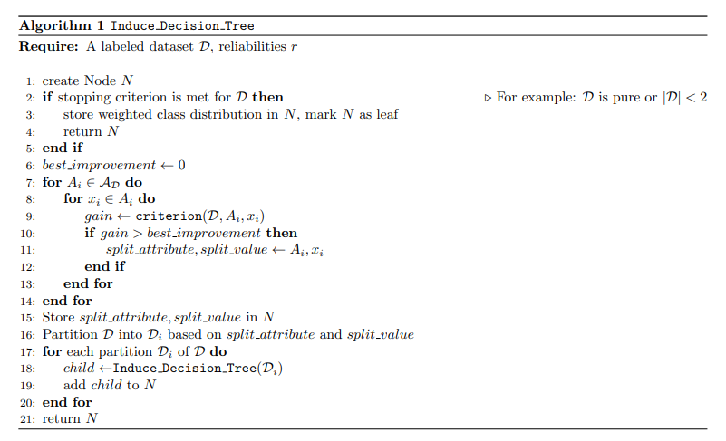
Background
Missing Data
  MCAR, MAR, MNAR
  Multiple Imputation: kNN Imputation
Decision Tree
  Divide and conquer
  Split dataset until a stopping criterion is met
  C4.5 and Missing Data
    Calculation of criterion
    Propagation of samples during training
    Propagation of samples during prediction

Slide 5
Related Work
Propagate Samples with MV down both branches [Fri76]
Impute most common value on the fly [CN89]
Lazy Decision Trees [FKY96]
Surrogate splits [BFOS84]
Branch Exclusive Splits [BR18]
MIA [TJH08]

Slide 6
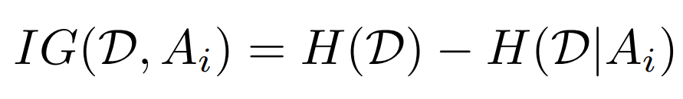
Expected Information Gain
Information Gain:
Expected Information Gain:

Slide 7
Learning with Expected IG

Slide 8
Evaluation
Setting
Six UCI ML Repo Datasets & One Synthetic Dataset
Baselines
  C45 MV Strategy
  Mean Imputation/C45
  kNN Imputation/C45
5-fold Cross Validation
  Training Data always has MV
  Three Scenarios for Test Data
  Amount of missing data in a range from 5% to 95%, using steps of 5%

Slide 9
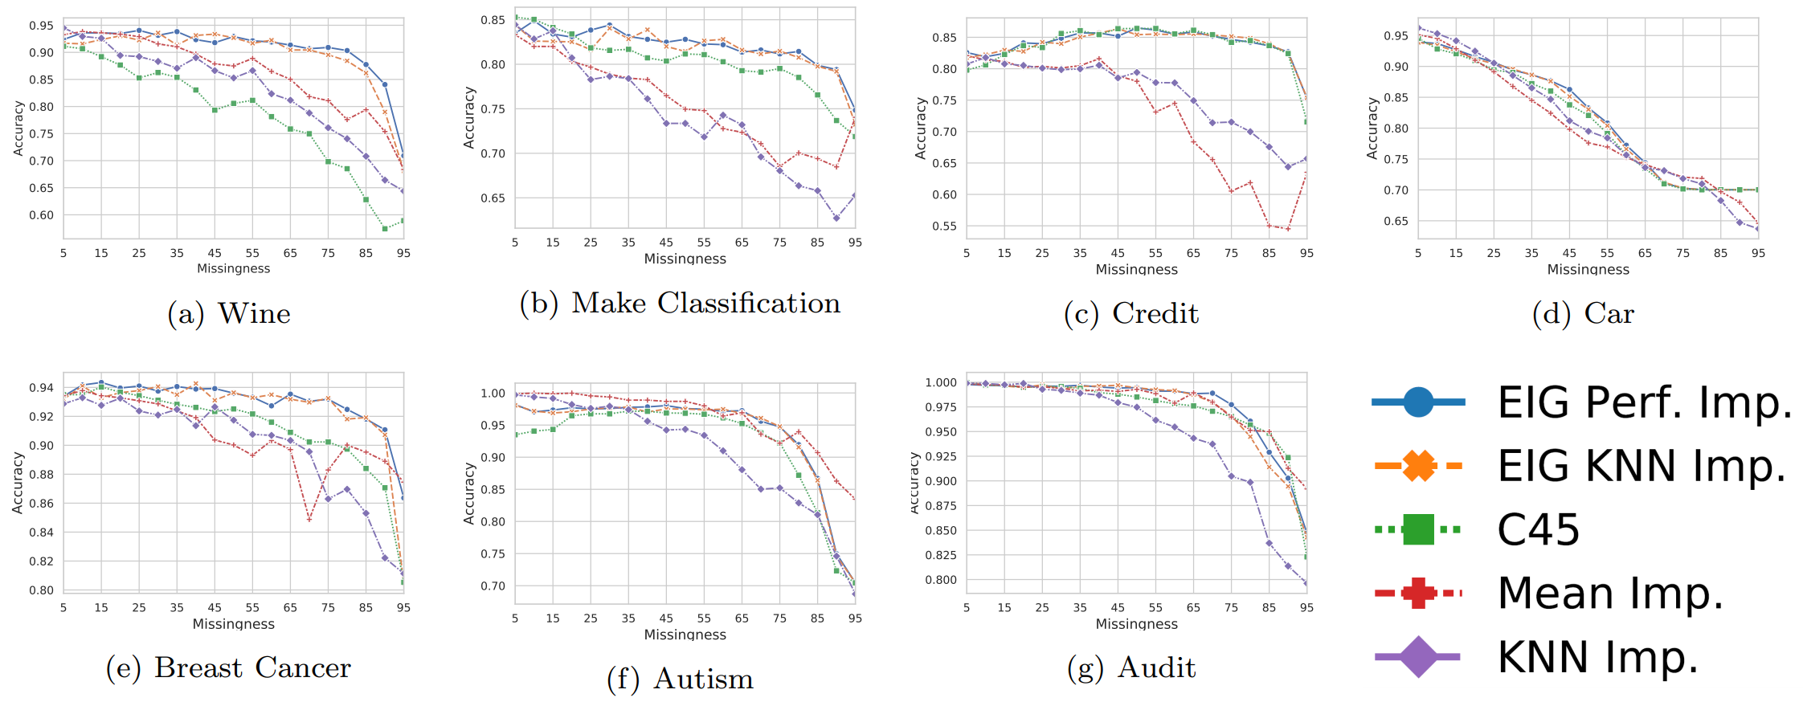
Evaluation
Prediction with Full Data

Slide 10
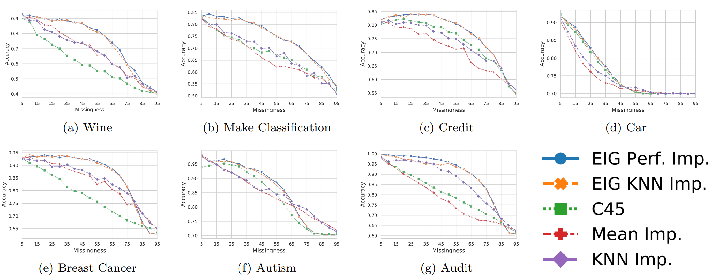
Evaluation
Prediction with Missing Data

Slide 11
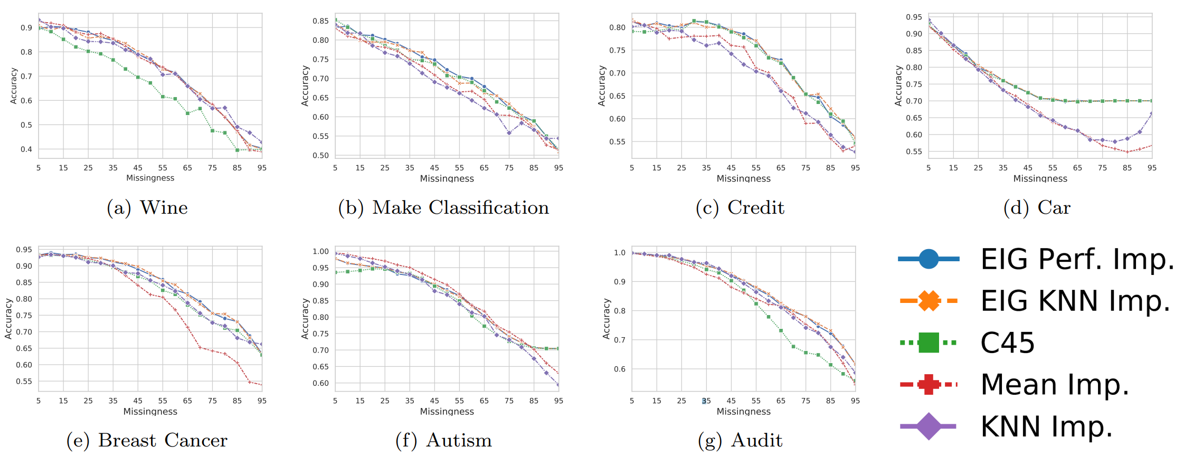
Evaluation
Prediction with Imputed Data

Slide 12
Conclusion
Discussion
  Most beneficial when data is also missing at prediction time
  A more accurate imputation method, provides better results
  Interdepedency of features is required
Future Work
  Analyze impact of the imputation method on the result
  Extend to further imputation methods
  Work on pruning methods and stopping criterion

Slide 13
Q&A
Any Questions?
Get in Contact
schreckenberger@es.uni-mannheim.de

Slide 14
REFERENCES
[Fri76] Jerome H Friedman. A recursive partitioning decision rule for nonparametric classication. IEEE Trans. Comput., 26(SLAC-PUB-1573-REV):404, 1976.
[CN89] Peter Clark and Tim Niblett. The CN2 induction algorithm. Machine learning, 3(4):261{283, 1989.
[FKY96] Jerome H Friedman, Ron Kohavi, and Yeogirl Yun. Lazy decision trees. In AAAI/IAAI, Vol. 1, pages 717-724, 1996.
[BFOS84] L Breiman, JH Friedman, R Olshen, and CJ Stone. Classication and regression trees. 1984.
[BR18] Cedric Beaulac and Jerey S Rosenthal. Best: A decision tree algorithm that handles missing values. arXiv preprint arXiv:1804.10168, 2018.
[TJH08] Beth Twala, MC Jones, and David J Hand. Good methods for coping with missing data in decision trees. Pattern Recognition Letters, 29(7):950{956, 2008.

