Slide 1
Combining Symbolic and Statistical Knowledge for Goal Recognition in Smart Home Environments
CoMoRea‘21
Nils Wilken and Heiner Stuckenschmidt
University of Mannheim
Contact: wilken@es.uni-mannheim.de

Slide 2
Agenda
Motivation
Goal- and Plan Recognition
Towards a Hybrid Goal Recognition Approach
Conclusion and Future Work

Slide 3
Motivation

Slide 4
Motivation
The need to accurately recognize the goals and plans of an observed agent is increasingly required in several tasks
  Multi-agent systems
  Human-Robot Interaction
  …
In the area of Pervasive Computing, there is a high research interest in context-aware systems that intelligently support their users (e.g., Smart Home systems)

Slide 5
Motivation
We think that such systems would benefit not only from recognizing current activities, but also recognizing the longer termed goal to which a currently observed sequence of activities leads
This would provide context-aware systems with a larger potential of planning for proactive support of a user

Slide 6
Goal- and Plan Recognition

Slide 7
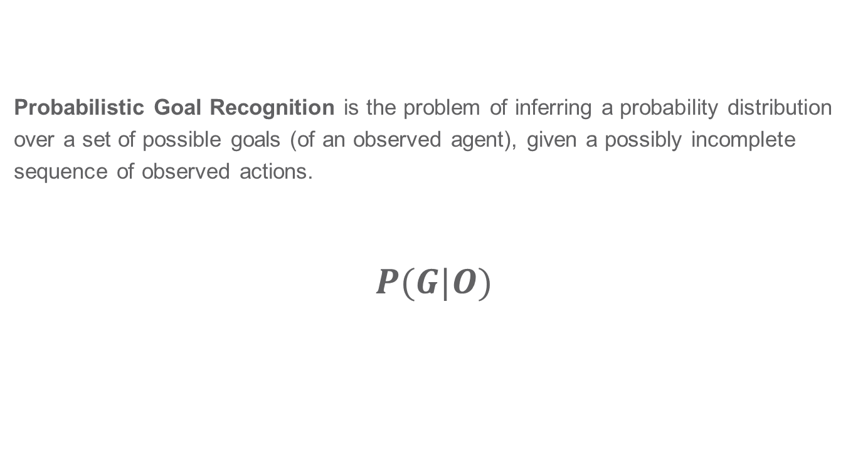
Problem Definition: Probabilistic Goal Recognition
Probabilistic Goal Recognition is the problem of inferring a probability distribution over a set of possible goals (of an observed agent), given a possibly incomplete sequence of observed actions.
$P(G|O)$

Slide 8
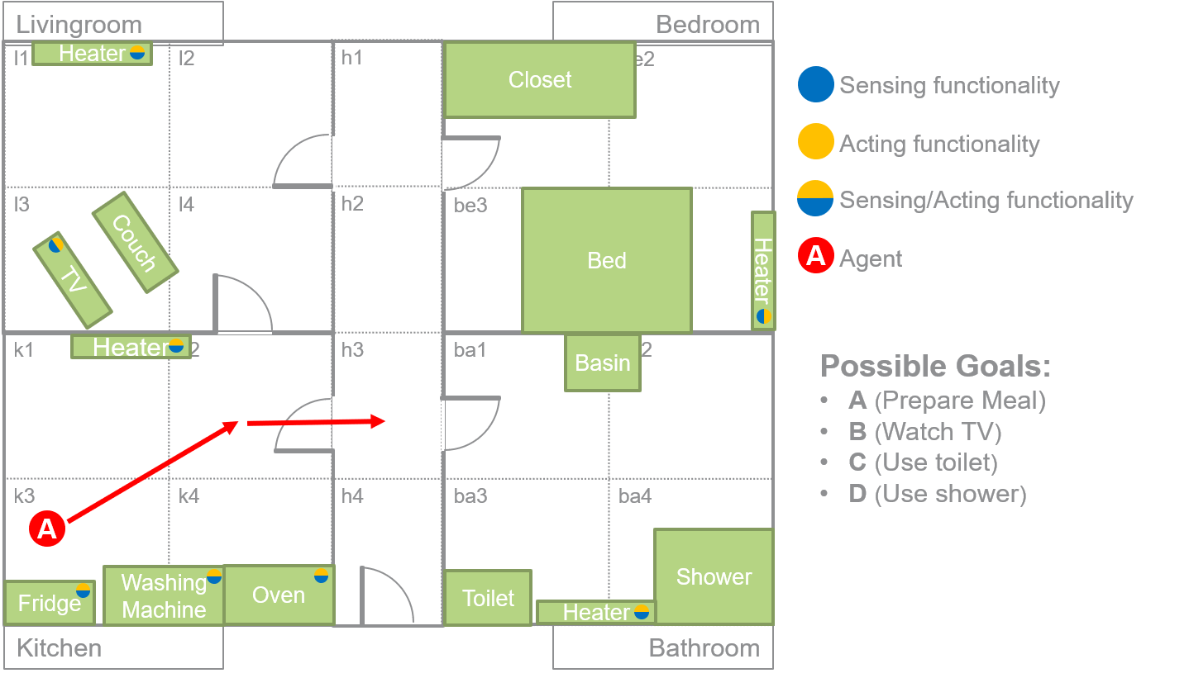
Goal Recognition

Slide 9
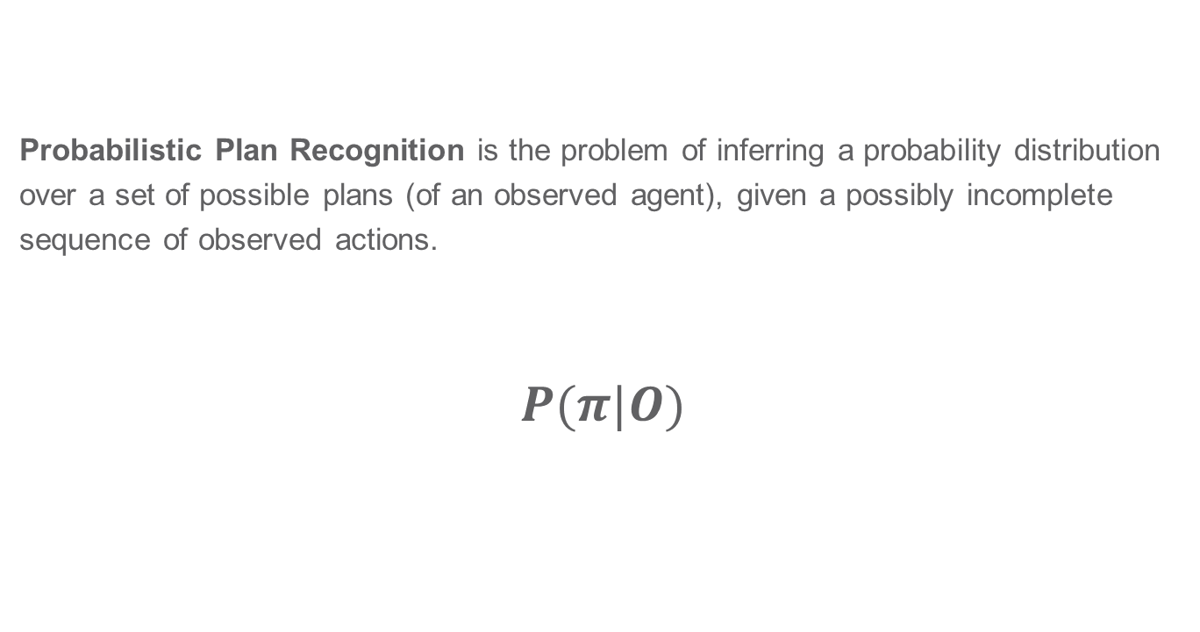
Problem Definition: Probabilistic Plan Recognition
Probabilistic Plan Recognition is the problem of inferring a probability distribution over a set of possible plans (of an observed agent), given a possibly incomplete sequence of observed actions.
$$P(π|O)$$

Slide 10
Towards a Hybrid Goal Recognition Approach

Slide 11
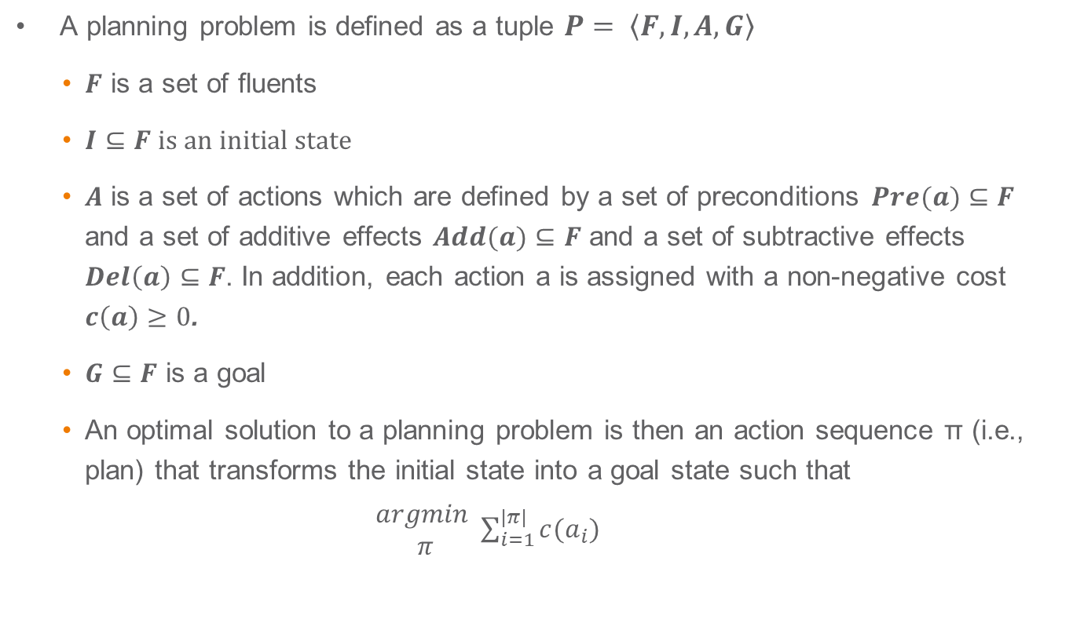
Classical Planning
A planning problem is defined as a tuple $P= \left\langle F,I,A,G\right\rangle$
  $F$ is a set of fluents
  $I⊆F is an initial state$
  $A$ is a set of actions which are defined by a set of preconditions $Pre(a)⊆F$ and a set of additive effects $Add(a)⊆F$ and a set of subtractive effects $Del\left(a\right)⊆F$. In addition, each action a is assigned with a non-negative cost $c\left(a\right)≥0$.
  $G⊆F$ is a goal
  An optimal solution to a planning problem is then an action sequence π (i.e., plan) that transforms the initial state into a goal state such that
  $\begin{matrix}argmin \\ π\end{matrix}\sum_{i=1}^{|π|}{c(a_{i})}$

Slide 12
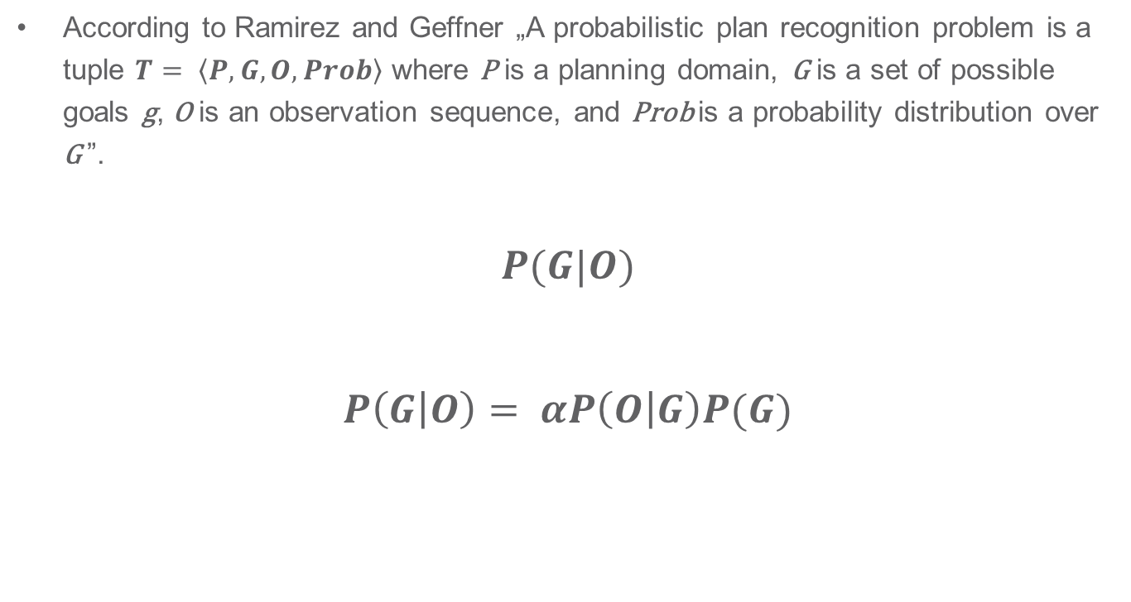
Plan Recognition as Planning (PRAP)
According to Ramirez and Geffner „A probabilistic plan recognition problem is a tuple $T= \left\langle P,G,O,Prob\right\rangle$ where P is a planning domain, G is a set of possible goals g, O is an observation sequence, and Prob is a probability distribution over G ”.
$$P(G|O)$$
$$P\left(G | O\right)= αP\left(O | G\right)P(G)$$

Slide 13
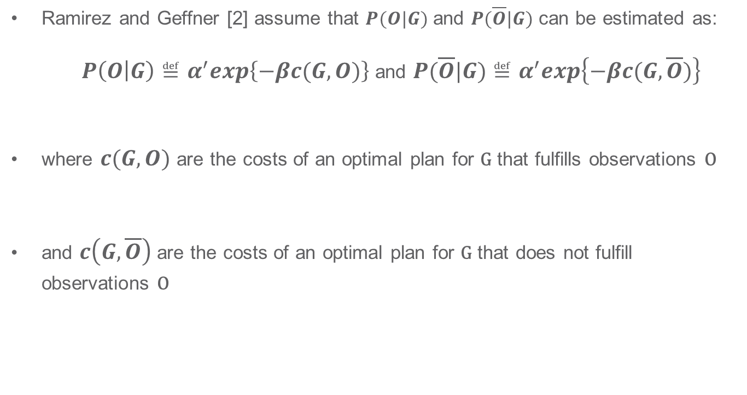
Plan Recognition as Planning (PRAP)
Ramirez and Geffner [2] assume that $P(O|G)$ and $P(\overline{O}|G)$ can be estimated as:
  $P\left(O | G\right)≝α^{′}exp\left\{−βc(G,O)\right\}$ and $P(\overline{O}|G)≝α^{′}exp\left\{−βc(G,\overline{O})\right\}$
where $c(G,O)$ are the costs of an optimal plan for G that fulfills observations O
and $c\left(G,\overline{O}\right)$ are the costs of an optimal plan for G that does not fulfill observations O

Slide 14

Plan Recognition as Planning (PRAP)
Hence, $P\left(O | G\right)$ can be estimated as:
$$P\left(O | G\right)= \frac{odds(O|G)}{1+odds(O|G)}=\frac{exp\left\{−βΔ(G,O)\right\}}{1+exp\left\{−βΔ(G,O)\right\}}$$
where $Δ\left(G,O\right)=c\left(G,O\right)−c(G,\overline{O})$

Slide 15
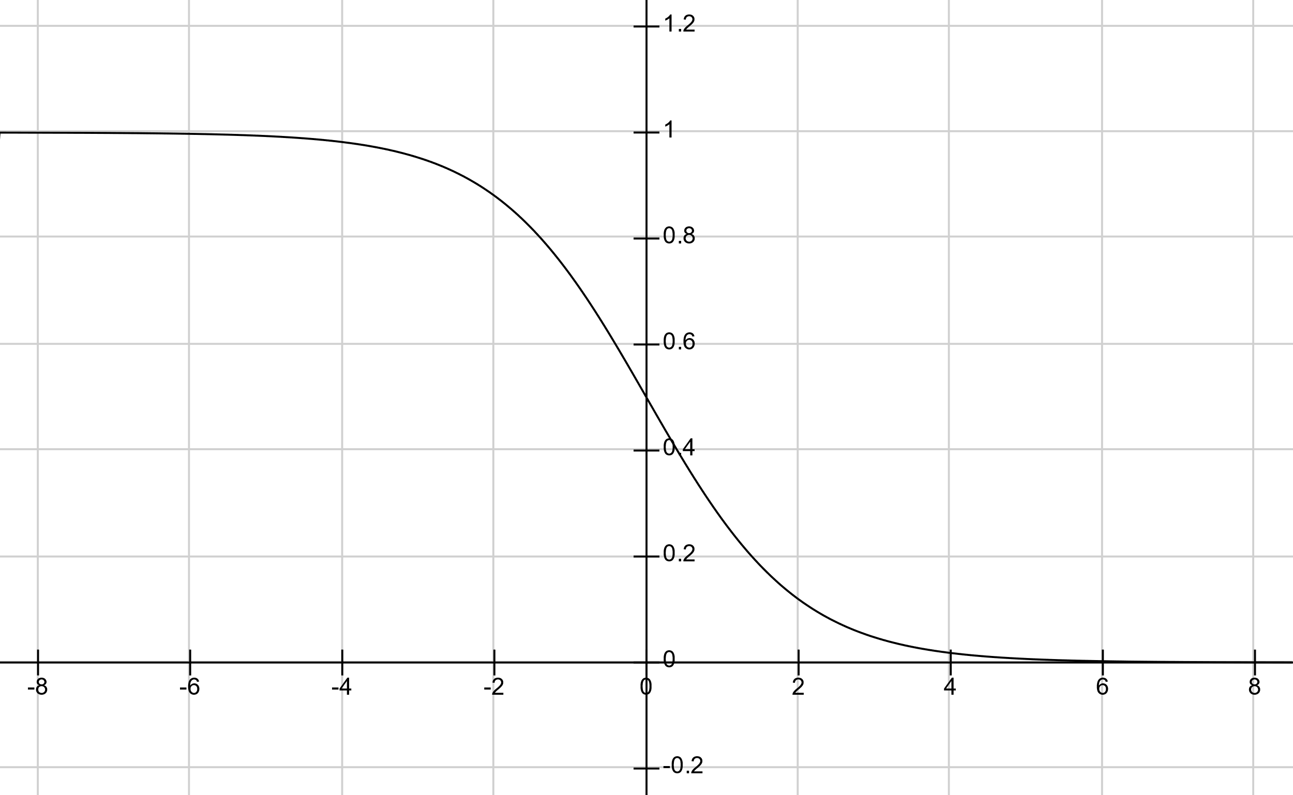



Plan Recognition as Planning (PRAP)
$$P(O|G)$$
$$β=1$$
$$∆(O,G)$$

Slide 16
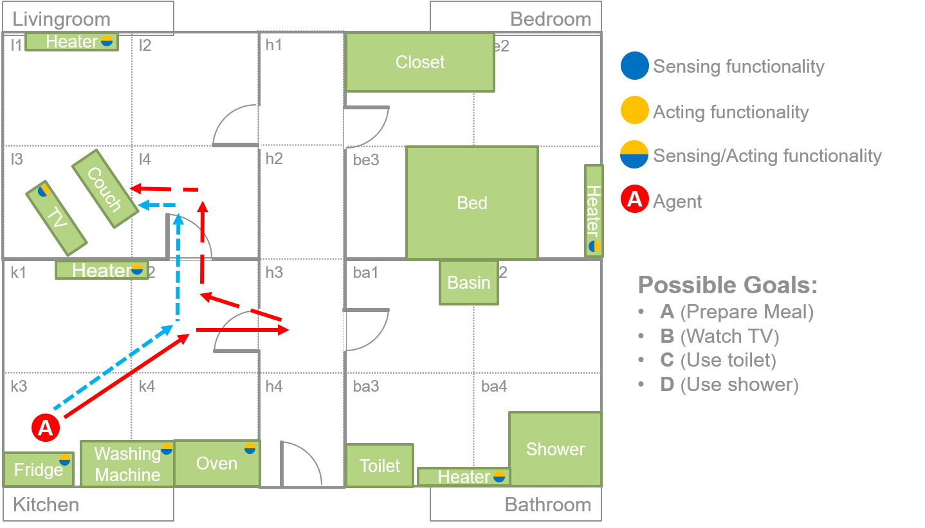

Plan Recognition as Planning (PRAP)
→
$$∆\left(O,G\right)=5−3=2$$

Slide 17
Shortcomings of PRAP

Slide 18
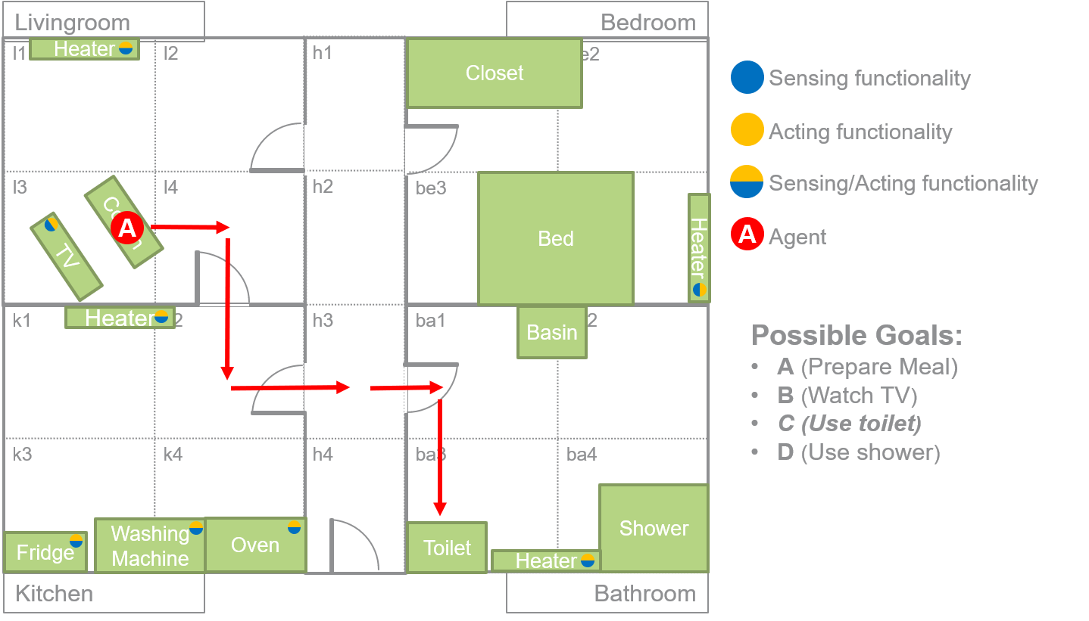
Shortcomings of PRAP

Slide 19
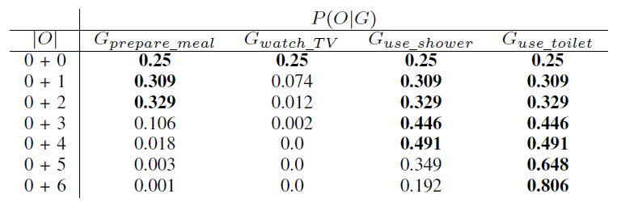
Shortcomings of PRAP

Slide 20

Shortcomings of PRAP

Slide 21
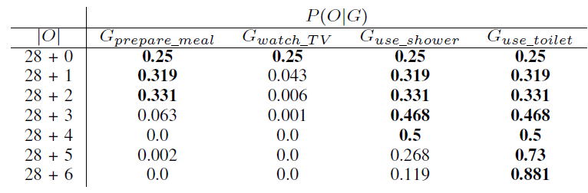
Shortcomings of PRAP
E1
The predicted set of most probable goals does not change although intuitively the additional information in E2 should have an influence on the prediction
E2

Slide 22
Towards a Hybrid Goal Recognition Approach

Slide 23
Approach: Bayesian Network Model
Nodes of the BNM are generated based on the utilized planning domain:
Basically, Naive Bayes (NB) structure that assumes conditional independence between the fluents given a goal
goal
F_1
…
F_N

Slide 24
Approach: Combining PRAP and NB Model
To combine the two models, we used two approaches:
  Linear combination of the two models through a weighted sum
  „Tiebreaking“ the PRAP approach

Slide 25
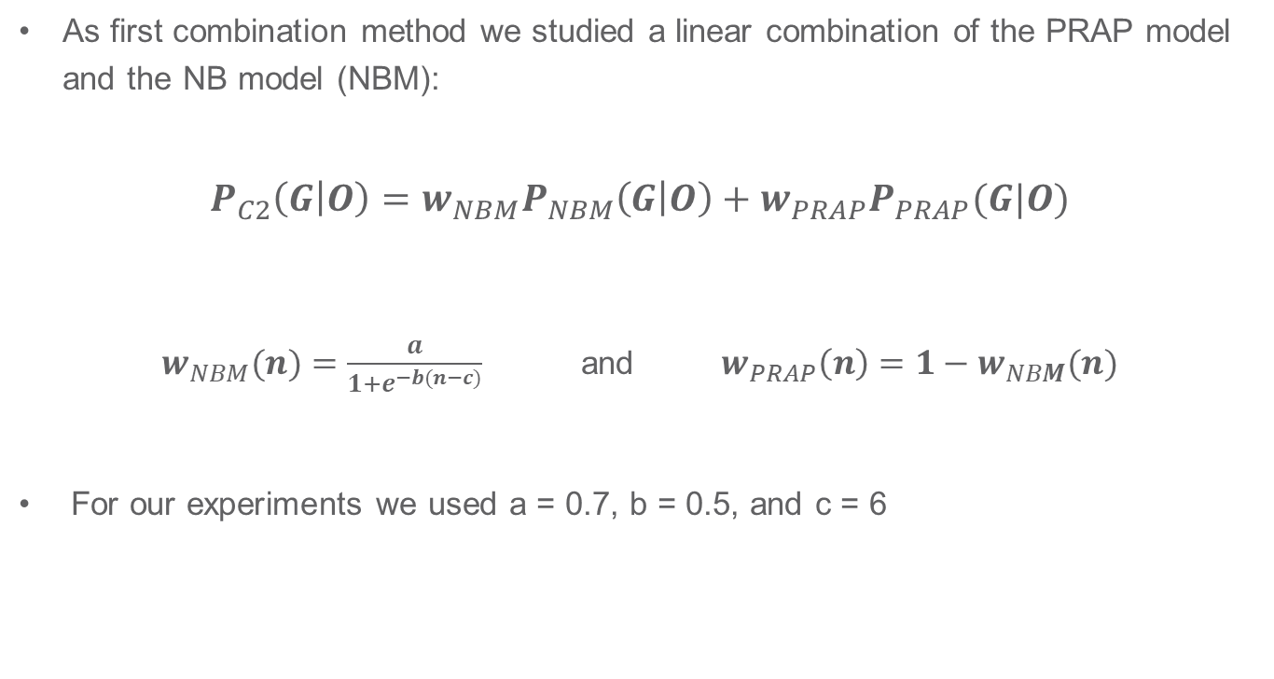
Approach: Combining PRAP and NB Model
As first combination method we studied a linear combination of the PRAP model and the NB model (NBM):
$$P_{C2}\left(G | O\right)=w_{NBM}P_{NBM}\left(G | O\right)+w_{PRAP}P_{PRAP}(G|O)$$
$w_{NBM}(n)=\frac{a}{1+e^{−b(n−c)}}$ and $w_{PRAP}\left(n\right)=1−w_{NBM}(n)$
For our experiments we used a = 0.7, b = 0.5, and c = 6

Slide 26
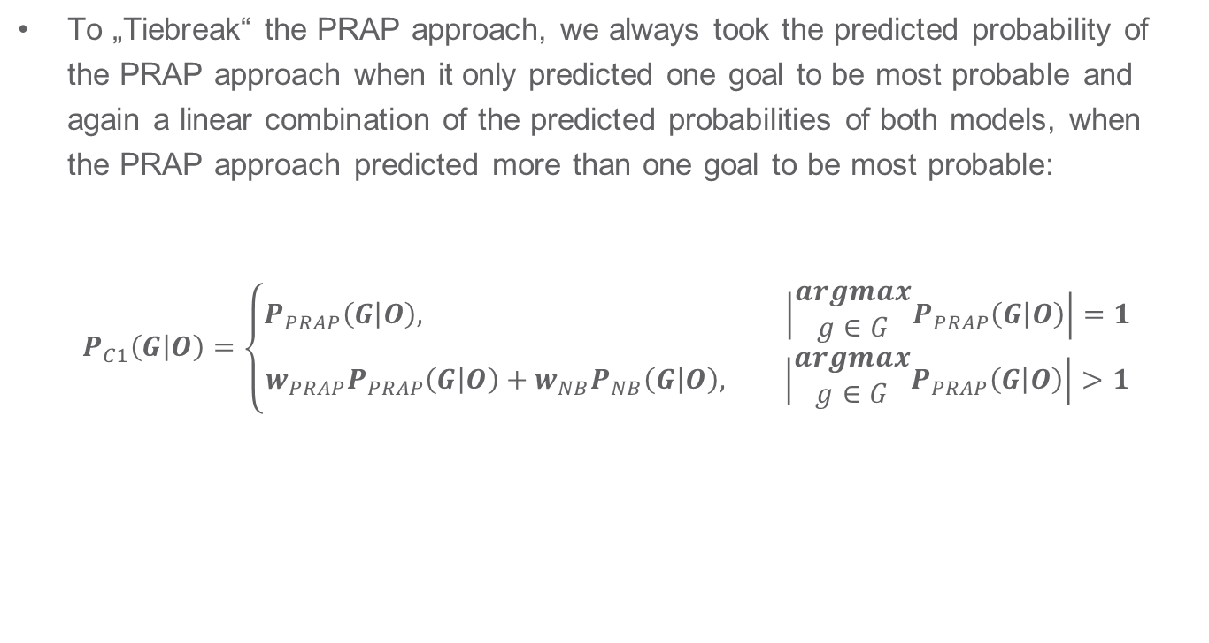
Approach: Combining PRAP and NB Model
To „Tiebreak“ the PRAP approach, we always took the predicted probability of the PRAP approach when it only predicted one goal to be most probable and again a linear combination of the predicted probabilities of both models, when the PRAP approach predicted more than one goal to be most probable:
$$P_{C1}\left(G | O\right)=\left\{\begin{aligned}P_{PRAP}\left(G | O\right), \left|\begin{matrix}argmax \\ g∈G\end{matrix}P_{PRAP}\left(G | O\right)\right|=1 \\ w_{PRAP}P_{PRAP}\left(G | O\right)+w_{NB}P_{NB}\left(G | O\right), \left|\begin{matrix}argmax \\ g∈G\end{matrix}P_{PRAP}\left(G | O\right)\right|>1\end{aligned}\right.$$

Slide 27
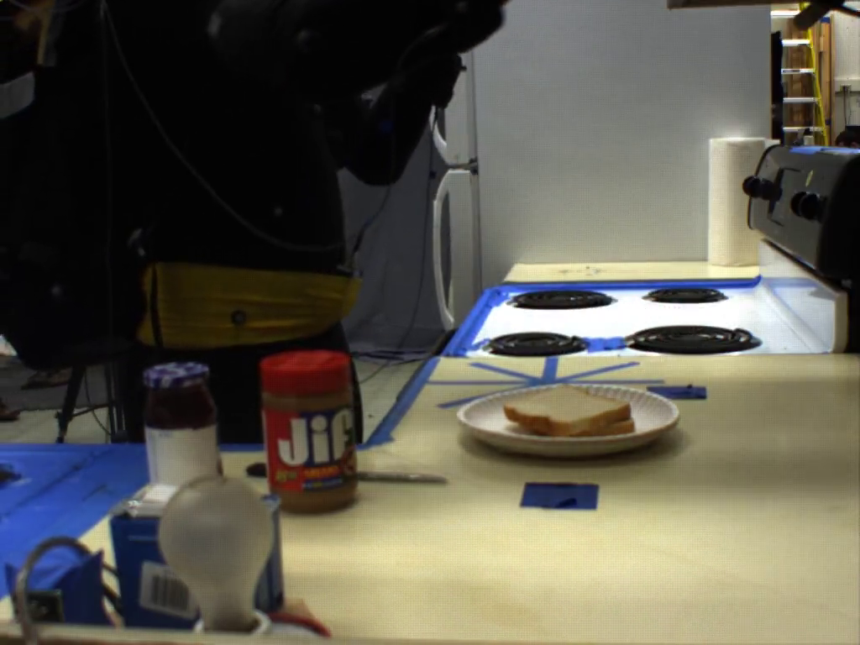
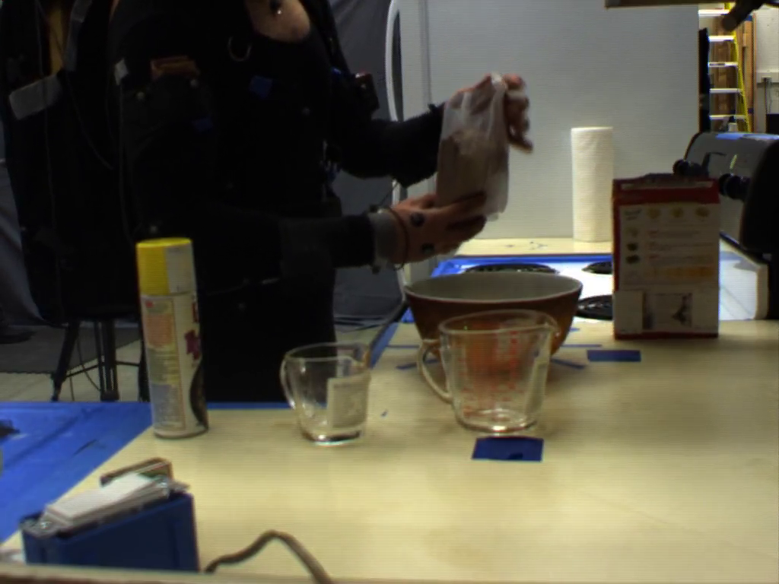
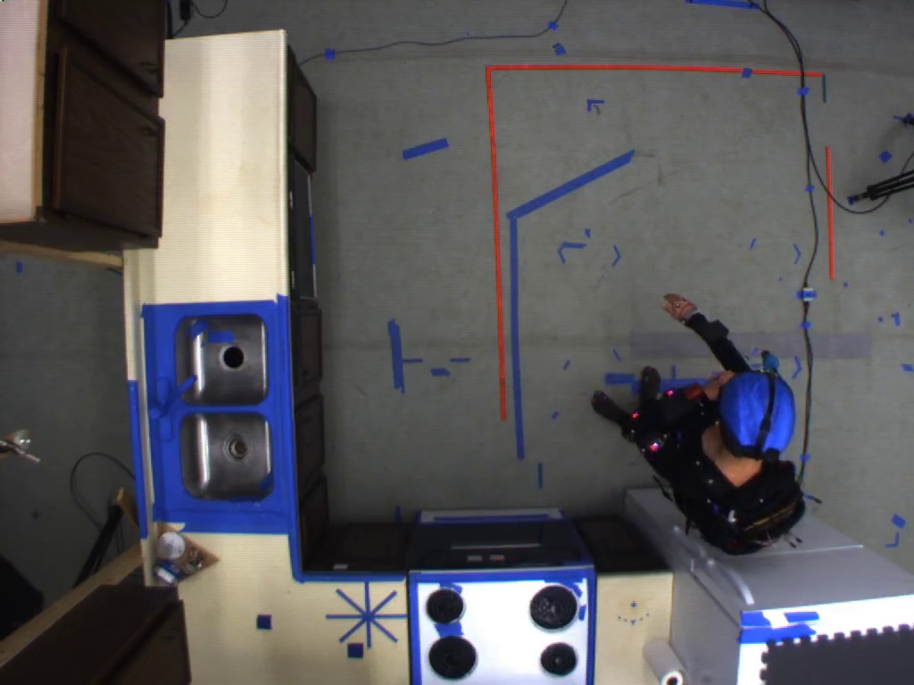
Evaluation Setup
We performed an empirical evaluation on the CMU Kitchen Dataset [4]
Contains data streams from different kinds of sensors (camera, accelerometers, etc.) from cooking processes of different persons
Persons cooked one out of five recipes (brownies, eggs, sandwich, salad, pizza)

Slide 28
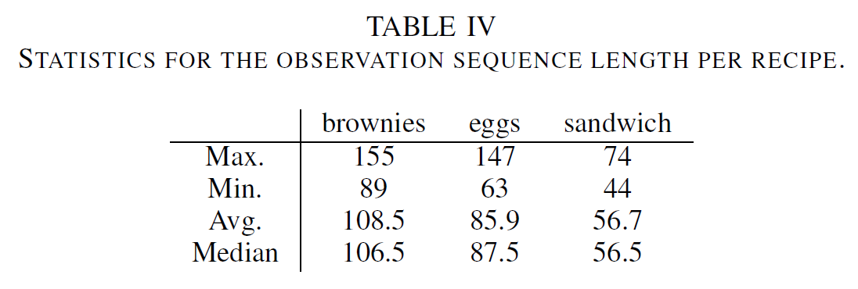
Evaluation Setup
We reused the results of a project at the University of Rostock [3] in which PDDL domains for these three recipes were created and action sequences were created from the video data

Slide 29
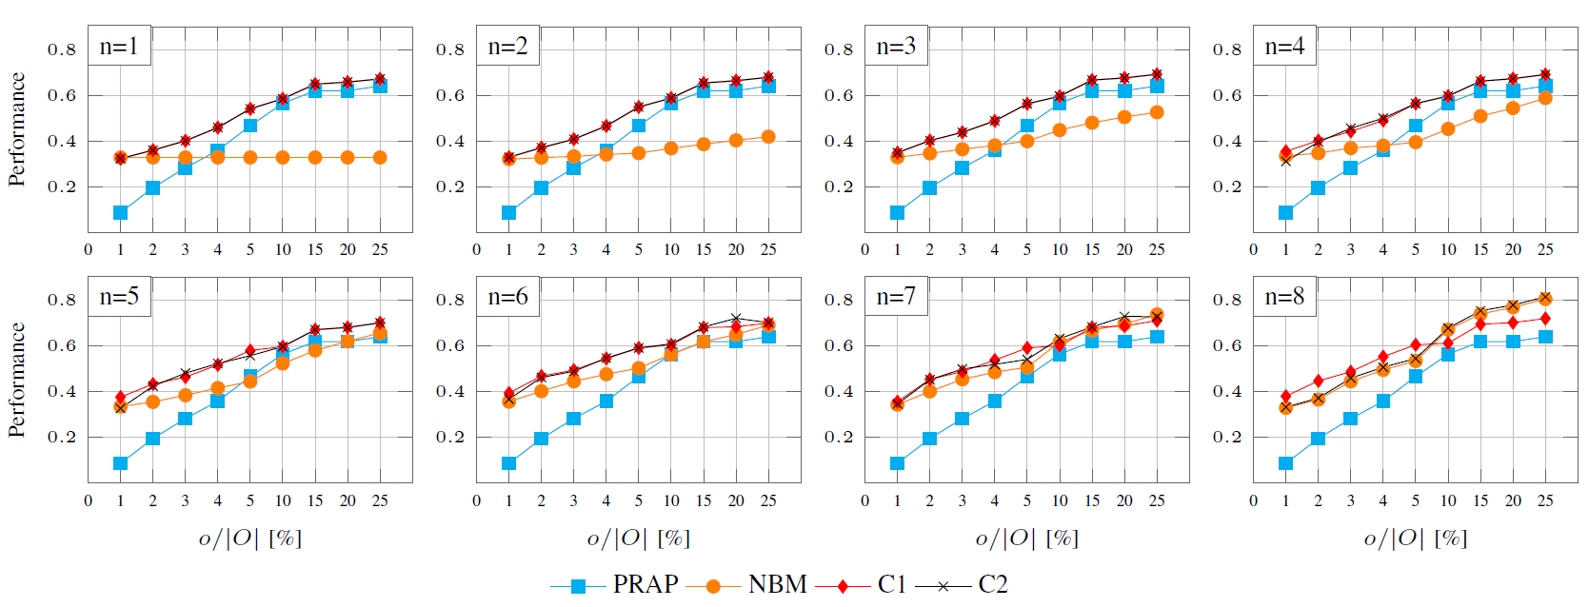
Evaluation Results

Slide 30
Conclusion and Future Work

Slide 31
Conclusion and Next Steps
The results show that hybrid approaches, which combine symbolic and data-driven approaches outperform methods that only rely onto techniques from one of these paradigms
Nevertheless, in these first experiments the combination method as well as the data-driven model are quite simple and hence, we plan to study the application of more sophisticated methods
Besides this, we are currently investigating how the „look-ahead“ capability of planning systems can be utilized to improve the predictions of data-driven methods in early stages of the observation sequence

Slide 32
Thank you for your attention!

Slide 33
Sources
[1] Wang, J., Chen, Y., Hao, S., Peng, X., & Hu, L. (2019). Deep learning for sensor-based activity recognition: A survey. Pattern Recognition Letters, 119, 3-11.
[2] Ramírez, M., & Geffner, H. (2010, July). Probabilistic plan recognition using off-the-shelf classical planners. In Proceedings of the AAAI Conference on Artificial Intelligence (Vol. 24, No. 1).
[3] Yordanova, K., Krüger, F., & Kirste, T. Semantic annotation for the cmu-mmac dataset. http://rosdok.uni-rostock.de/resolve/id/rosdok_document_0000012810
[4] http://kitchen.cs.cmu.edu/
[5] Kautz, H. A., & Allen, J. F. (1986, August). Generalized Plan Recognition. In AAAI (Vol. 86, No. 3237, p. 5).
[6] Charniak, E., & Goldman, R. P. (1993). A Bayesian model of plan recognition. Artificial Intelligence, 64(1), 53-79.

Slide 34
Approach: Bayesian Network Model
As a first step, to utilize statistical knowledge from historic data, we combined the PRAP approach with a Bayesian Network Model (BNM)
A
B
C
D
E

Slide 35

Plan Recognition

Slide 36
A short history
Early approaches to plan recognition relied on complete plan libraries that encode possible user behavior to recognize the current plan [5],[6]
However, creating such plan libraries requires large manual modeling effort and prohibits these approaches to recognize plans that were not explicitly modeled
Ramirez and Geffner [2] developed an approach, which is called “Plan Recognition as Planning” (PRAP), that is not longer based on plan libraries but on a domain theory (i.e., planning domains)
The approach decomposes a plan recognition problem into several planning problems

Slide 37
Heater
Livingroom
Bedroom
l1 | l2
l3 | l4
h1
h2
h3
h4
Be1 | Be2
be3 | be4
Closet
Sensing functionality
Acting functionality
Couch
Bed
Sensing/Acting functionality
Heater
TV
A
Agent
Heater
k1 | k2
k3 | k4
Basin
ba1 | ba2
ba3 | ba4
Possible Goals:
A (Prepare Meal)
B (Watch TV)
C (Use toilet)
D (Use shower)
A
Shower
Washing Machine
Oven
Toilet
Heater
Fridge
Kitchen
Bathroom

Slide 38
Heater
Livingroom
Bedroom
l1 | l2
l3 | l4
h1
h2
h3
h4
Be1 | Be2
be3 | be4
Closet
Sensing functionality
Acting functionality
Couch
Bed
Sensing/Acting functionality
Heater
TV
A
Agent
Heater
k1 | k2
k3 | k4
Basin
ba1 | ba2
ba3 | ba4
Possible Goals:
A (Prepare Meal)
B (Watch TV)
C (Use toilet)
D (Use shower)
A
Shower
Washing Machine
Oven
Toilet
Heater
Fridge
Kitchen
Bathroom

Slide 39
Heater
Livingroom
Bedroom
l1 | l2
l3 | l4
h1
h2
h3
h4
Be1 | Be2
be3 | be4
Closet
Sensing functionality
Acting functionality
Couch
Bed
Sensing/Acting functionality
A
Heater
TV
A
Agent
Heater
k1 | k2
k3 | k4
Basin
ba1 | ba2
ba3 | ba4
Possible Goals:
A (Prepare Meal)
B (Watch TV)
C (Use toilet)
D (Use shower)
Shower
Washing Machine
Oven
Toilet
Heater
Fridge
Kitchen
Bathroom

Slide 40
Heater
Livingroom
Bedroom
l1 | l2
l3 | l4
h1
h2
h3
h4
Be1 | Be2
be3 | be4
Closet
Sensing functionality
Acting functionality
Couch
Bed
Sensing/Acting functionality
A
Heater
TV
A
Agent
Heater
k1 | k2
k3 | k4
Basin
ba1 | ba2
ba3 | ba4
Possible Goals:
A (Prepare Meal)
B (Watch TV)
C (Use toilet)
D (Use shower)
2x
Shower
Washing Machine
Oven
Toilet
Heater
Fridge
Kitchen
Bathroom

Slide 41
Heater
Livingroom
Bedroom
l1 | l2
l3 | l4
h1
h2
h3
h4
Be1 | Be2
be3 | be4
Closet
Sensing functionality
Acting functionality
Sensing/Acting functionality
Couch
Bed
Heater
TV
A
A
Agent
Heater
k1 | k2
k3 | k4
Basin
ba1 | ba2
ba3 | ba4
Possible Goals:
A (Prepare Meal)
B (Watch TV)
C (Use toilet)
D (Use shower)
Shower
Washing Machine
Oven
Toilet
Heater
Fridge
Kitchen
Bathroom

Slide 42
Shortcomings of PRAP

Slide 43

Approach: Naive Bayes Model
Hence, we model the following probability:
$$P\left(G | O\right)=P\left(G | F_{1},…,F_{N}\right)=αP\left(F_{1},…,F_{N} | G\right)P\left(G\right)=αP(G)\prod_{i=1}^{N}{P(F_{i}|G)}$$

Slide 44
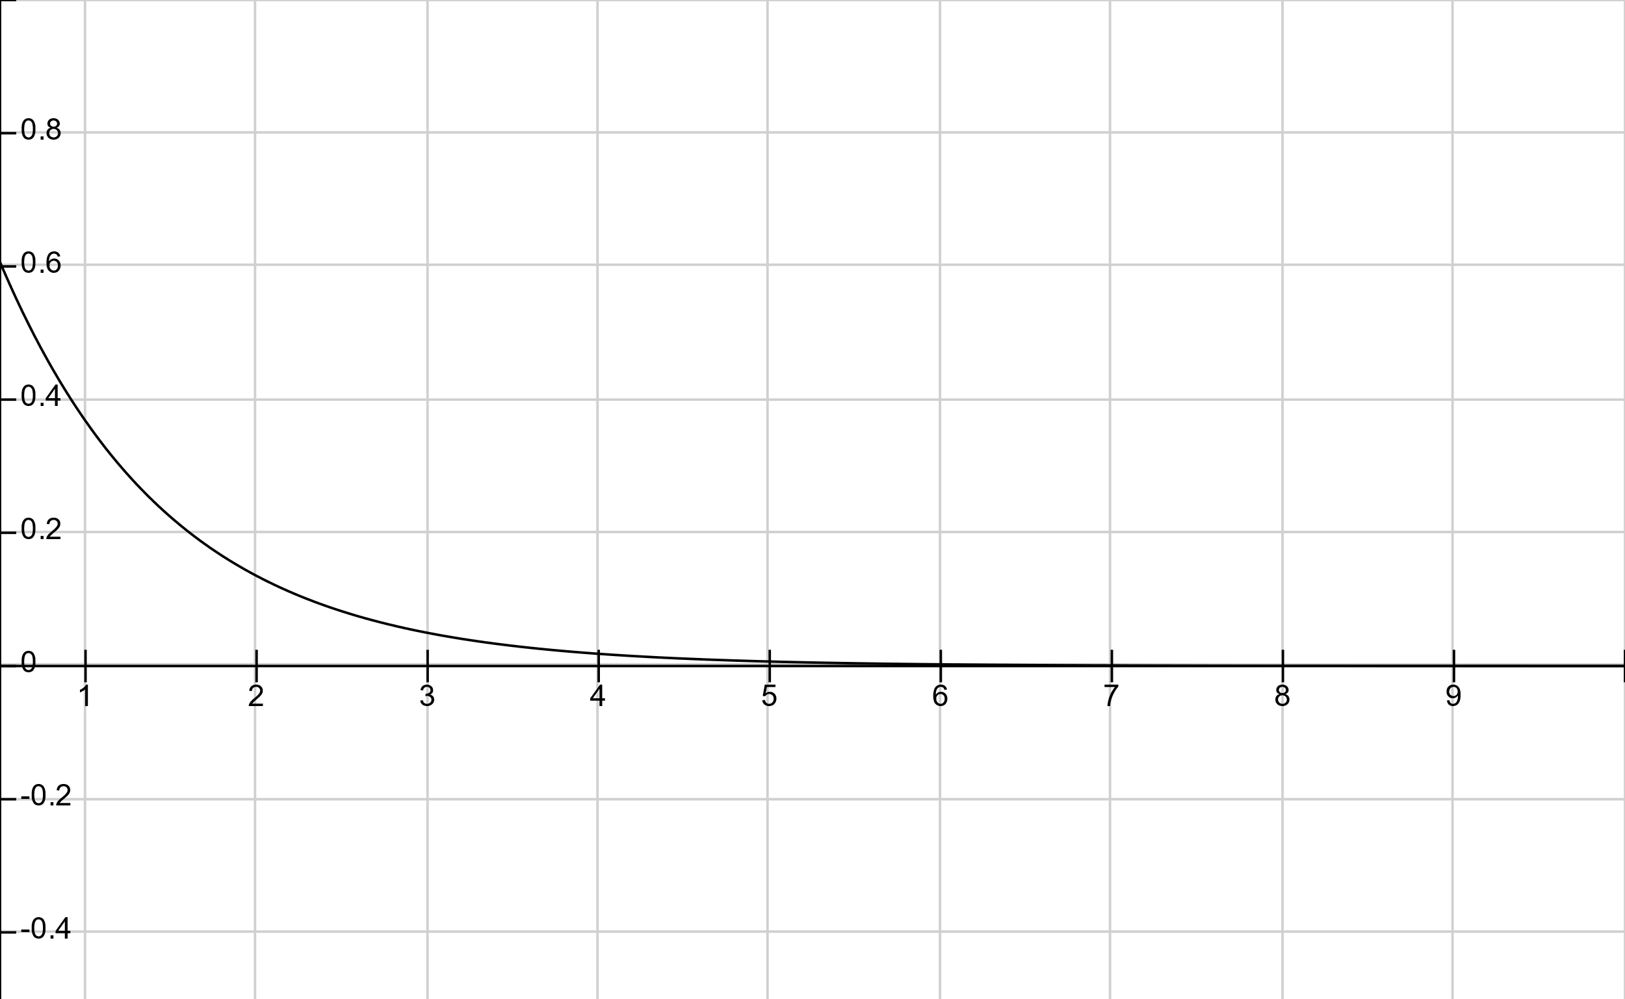



Plan Recognition as Planning (PRAP)
$$exp\left\{−βc(O,G)\right\}$$
$$β=1$$
$$c(O,G)$$

