Slide 1
Restructuring of Hoeffding Trees for
Trapezoidal Data Streams
Christian Schreckenberger, Tim Glockner, Christian Bartelt, Heiner Stuckenschmidt
CLEATED@IDCM, November 17th, 2020, Sorrento (Italy)

Slide 2
Outline
 | Agenda
1. | Introduction
2. | Dynamic Fast Decision Tree
3. | Evaluation
4. | Conclusion

Slide 3
Outline
 | Agenda
1. | Introduction
2. | Dynamic Fast Decision Tree
3. | Evaluation
4. | Conclusion

Slide 4
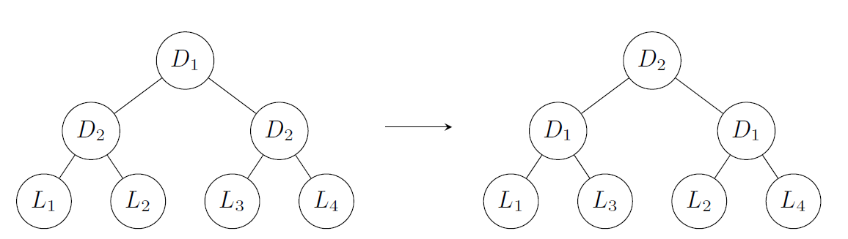
Sensor Networks as an Example of Time Evolving Data
Sensor Networks are inherently evolving dynamically over time
Data is recorded over time
New sensors can and will be added over time
  Leading to new feature streams to emerge
Data(streams) will be lost due to
  Sensors that break
    Sensor gets replaced
    Sensor does not get replaced
  Transmission failures
Notes:
Research is situated in unreliable and dynamic environments
Sensor Networks as a bigger class are an example
While they have a lot of problems
such as clock drift etc.
they also have two highly relevant problems for machine learning
Example of CrowdSensing, Smart City, UAVs carrying sensors
Depending on the use case problems are more or less likely to happen

Slide 5
Trapezoidal Data Streams
This work focusses on emerging features
Problem was named „Trapezoidal Data Streams“
Term introduced by Zhang et al. (2016)
  Increasing number of data instances
  Expanding feature space

Slide 6
Hoeffding Trees in a Nutshell
The algorithm by Domingos (2000) induces decision trees from non trapezoidal data streams
Main idea:
  Data instances are passed down the tree until a leaf is reached
  Each leaf stores data instances as counts in the so called n_ijk matrix.
  Once the Hoeffding bound is satisfied the respective leaf is split according to the best feature
The Hoeffding tree algorithm can induce decision trees based on the Hoeffding bound in an online and memory efficient manner

Slide 7
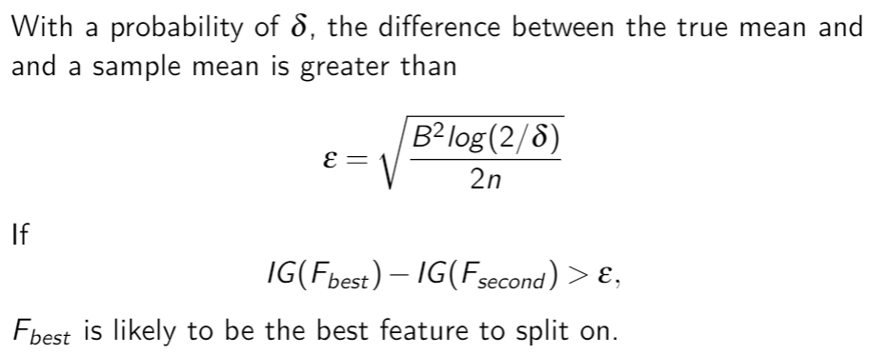
Hoeffding Bound

Slide 8
Problems with Emerging Features
Meaningful features will emerge
Likely to induce splits in many leaves
  Makes the tree unecessarily big
  Needs a lot instances to reach each leaf
Some decision nodes become redudant
  Which also increases the tree size unnecessarily

Slide 9
Outline
 | Agenda
1. | Introduction
2. | Dynamic Fast Decision Tree
3. | Evaluation
4. | Conclusion

Slide 10
Approach
The proposed algorithm Dynamic Fast Decision Trees takes key concepts from Hoeffding trees.
Handling of emerging features:
  Tree is restructured on a predefined interval on a global scope: m
  Reordering of decision nodes from root to leaves based on information gain
  Pruning removes unnecessary decision nodes

Slide 11
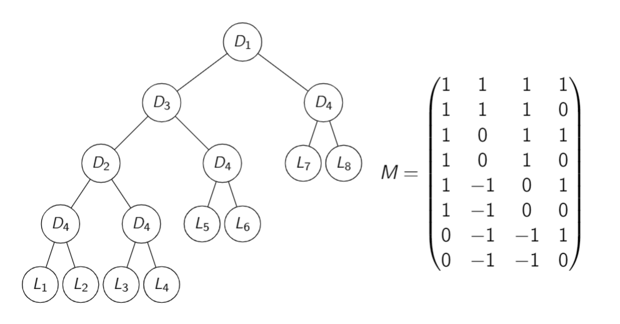
Decision Matrix
Matrix representing the structure of the decision tree
Each column represents a binary decision
Each row represents a leaf
Combined with the array of leaves a full decision tree can be reconstructed

Slide 12
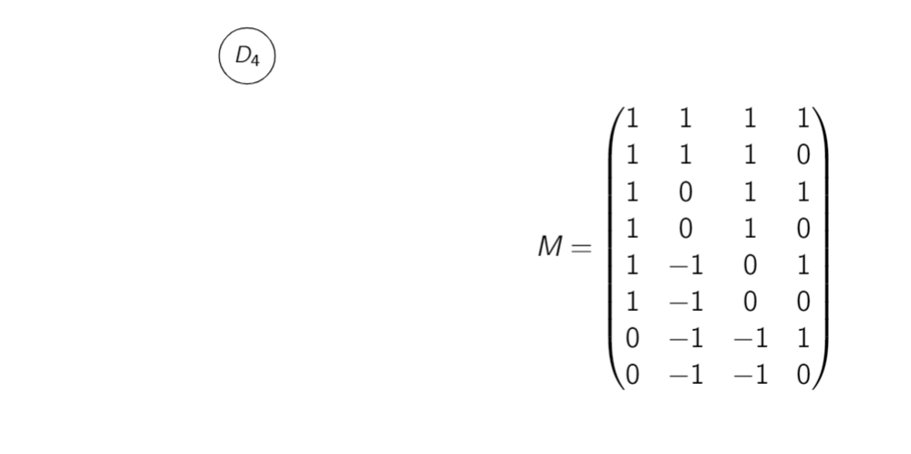
Restructuring

Slide 13
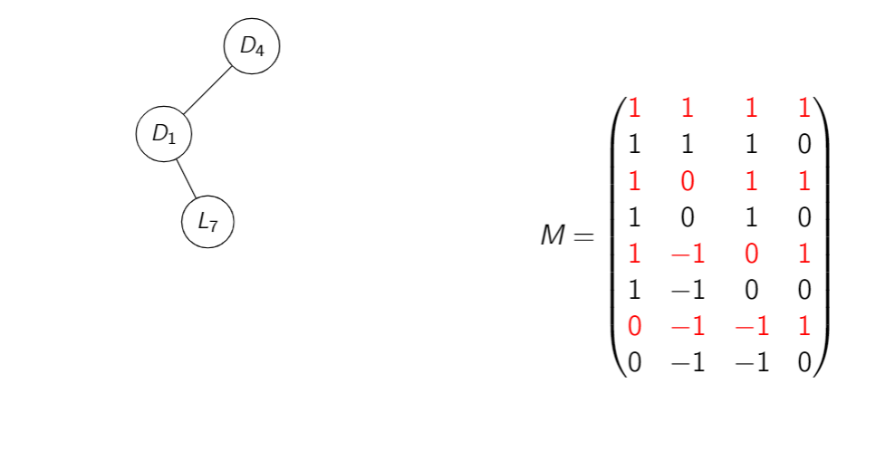
Restructuring

Slide 14
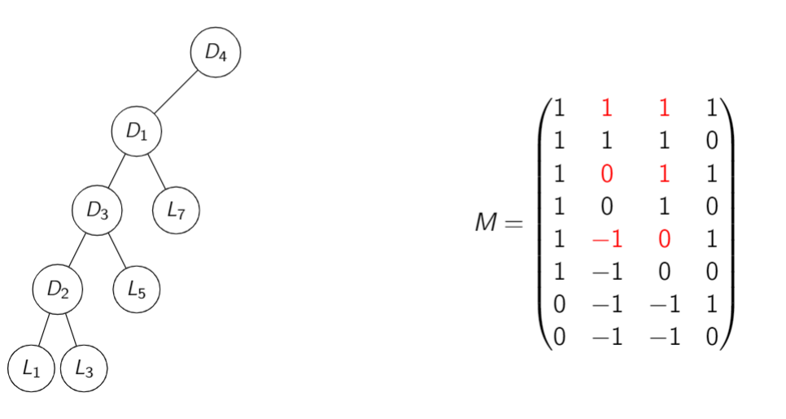
Restructuring

Slide 15
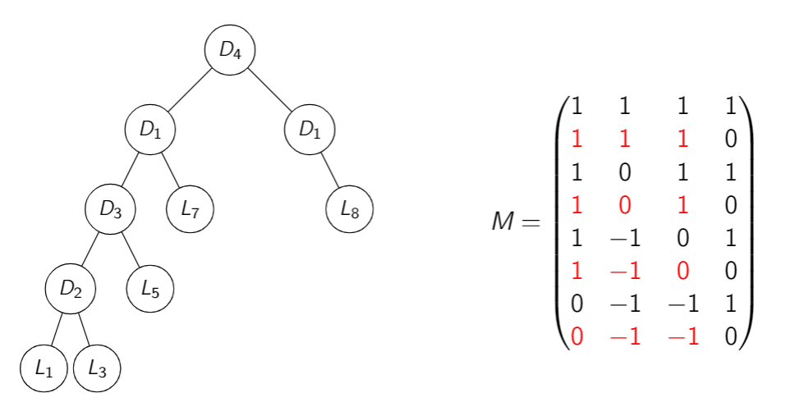
Restructuring

Slide 16
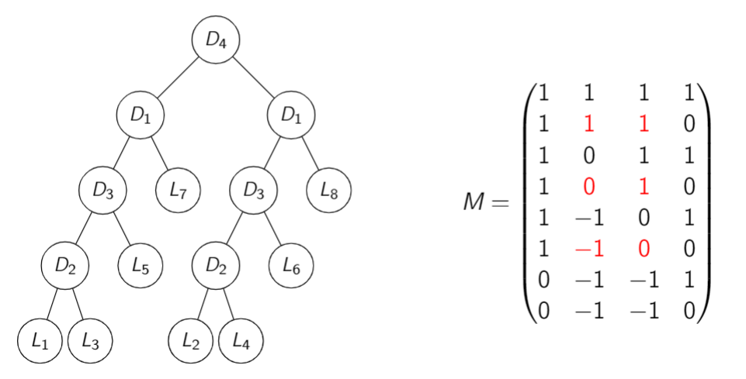
Restructuring
Notes:
Resulting in restructured tree with exact same decision matrix and leaves
Making exactly the same predictions
Decision nodes yielding little information gain close to the leaves
Some of these decision nodes may yield no additional information gain

Slide 17
Restructuring
Resulting in restructured tree with exact same decision matrix and leaves
Making exactly the same predictions
Decision nodes yielding little information gain close to the leaves
Some of these decision nodes may yield no additional information gain

Slide 18
Information Gain
Information gain has to be calculated when it is needed because of
  Statistical fluctuations
  Dependent features
and can be performed through
  Selection of relevant leaves
  Aggregation of their statistics in n_ijk.

Slide 19
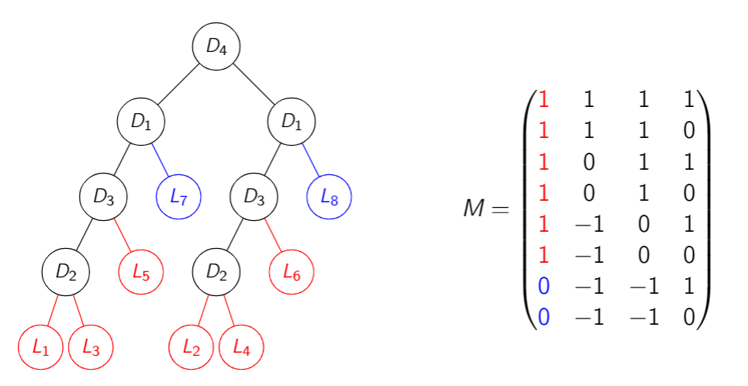
Information Gain – Calculate for D1

Slide 20
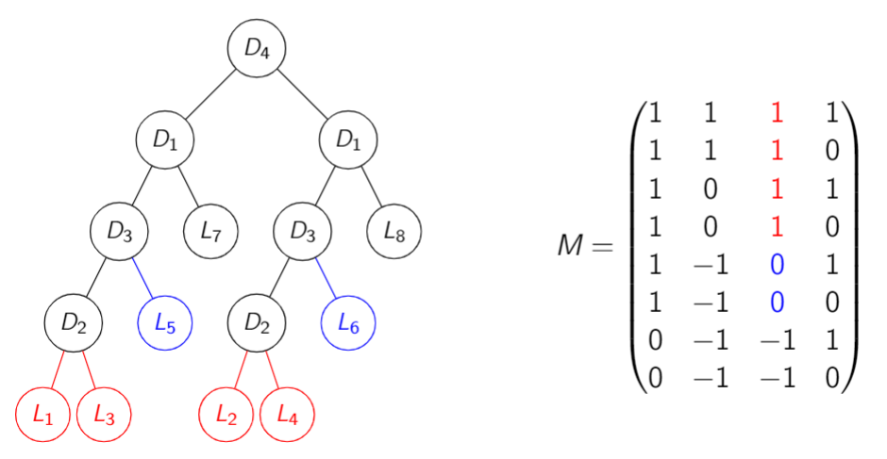
Information Gain – Calculate for D3

Slide 21
Pruning - Conditions
Goal: Redundant decision nodes should be identified and replacedby a leaf node.
Conditions:
  both children predict the same label
  Hoeffding bound evaluated with higher value for δ and true mean of 0 and IG(F) ≤ ε
  threshold of minimum numbers of samples seen in each leaf isreached

Slide 22
Pruning
Both children are leaves:
  conditions specified are tested
  if satisfied, sample counts are aggregated into a new leaf and attached in place of that decision node
  otherwise, subtree is not pruned
At least one child is a decision node:
  in a recursive manner, children that are not leaves are processed the same way
  this might lead to children being replaced by leaf nodes
  steps above are then applied to the decision node

Slide 23
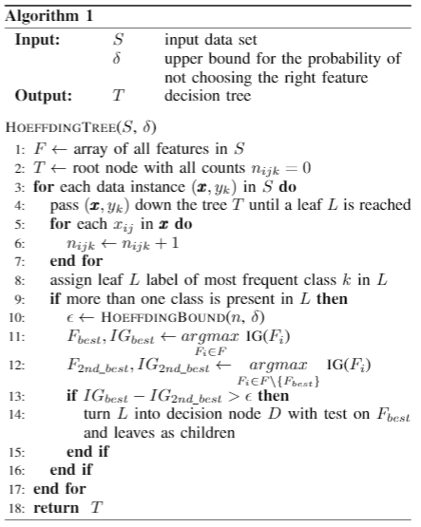
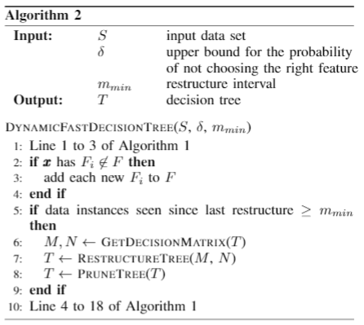
Full DFDT Algorithm

Slide 24
Outline
 | Agenda
1. | Introduction
2. | Dynamic Fast Decision Tree
3. | Evaluation
4. | Conclusion

Slide 25
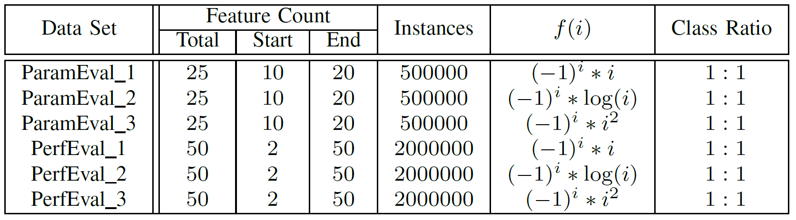
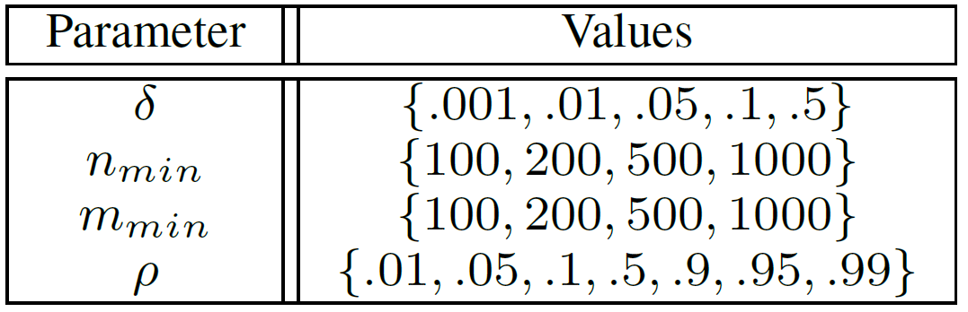
Setting
Data: synthetic data
Approach:
  Comparison between VFDT and DFDT on different data sets
  With various parameter settings
  Samples were used to predict and measure accuracy
  and then fed to the learning algorithm

Slide 26
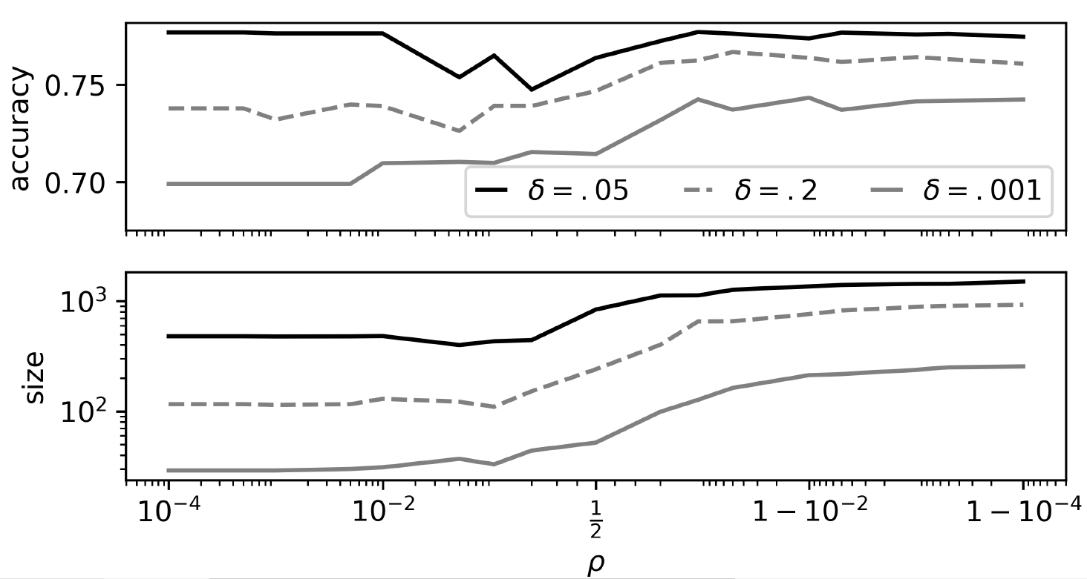
Effects of varying parameter on ParamEval_2

Slide 27
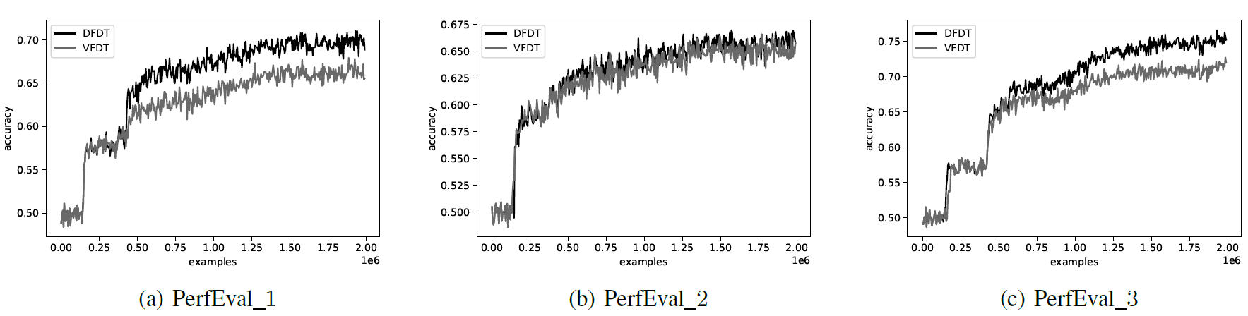
Results for the Performance Evaluation

Slide 28
Outline
 | Agenda
1. | Introduction
2. | Dynamic Fast Decision Tree
3. | Evaluation
4. | Conclusion

Slide 29
Conclusion
We introduced a new algorithm to deal with trapezoidal data streams
DFDT can deal better with parameters that increase the speed of the growth
However, dropping decision nodes, also means dropping samples
  The best trees had relatively high values for rho
Future Work
  Extend evaluation on real world data cases
  Force splits to be able to push up decision nodes even further
  Extend to dropping features, here restructuring may be beneficial over dropping whole subtrees

Slide 30
Q&A
Any Questions?
Get in Contact
schreckenberger@es.uni-mannheim.de

